Slide 2
Monday
Today we will start to look at poetry.
Next Friday we will hold a poetry festival to share all your brilliance!
Your poem will be accompanied by art work too and displayed

Slide 3
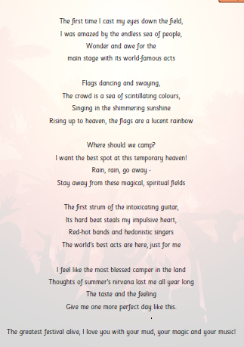
Features of a poem
Add notes to your copy noting:
What grammatical features can you spot?
What other poetry features are evident?

Slide 4
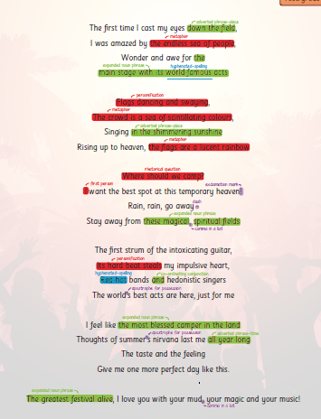

Slide 5
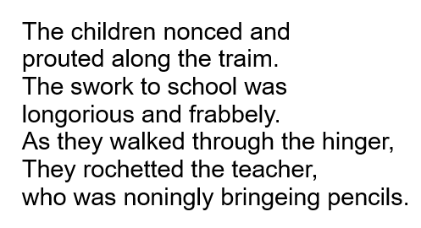
Can you read this? What does it mean?

Slide 6
We are able to work out what some of it means because we have a good knowledge of word class. Write on your copy what you think it might mean

Slide 7
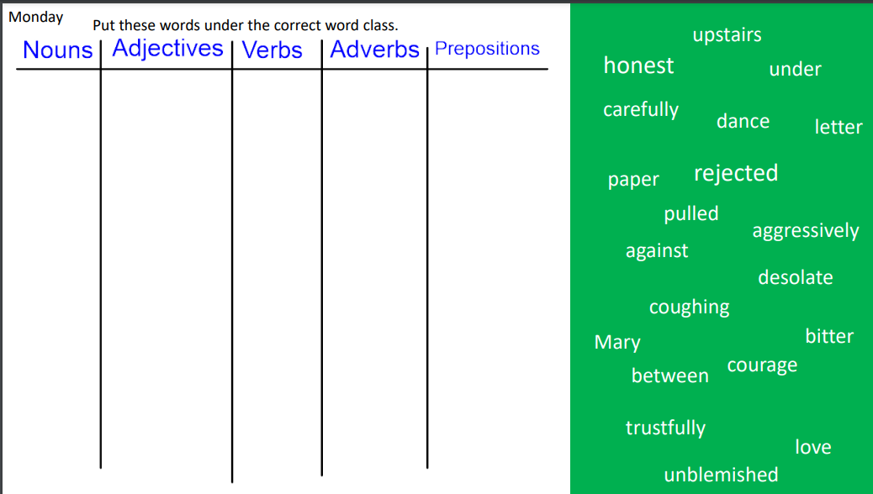

Slide 8
For the next two weeks, we will be focusing on a poem about a ferocious beast!
h ttp://www.bbc.co.uk/learningzone/clips/lewis-carrol-jabberwocky/5322.html
Have a listen and let me know what you think! It is from a very famous story! Any ideas which one?

