Slide 1

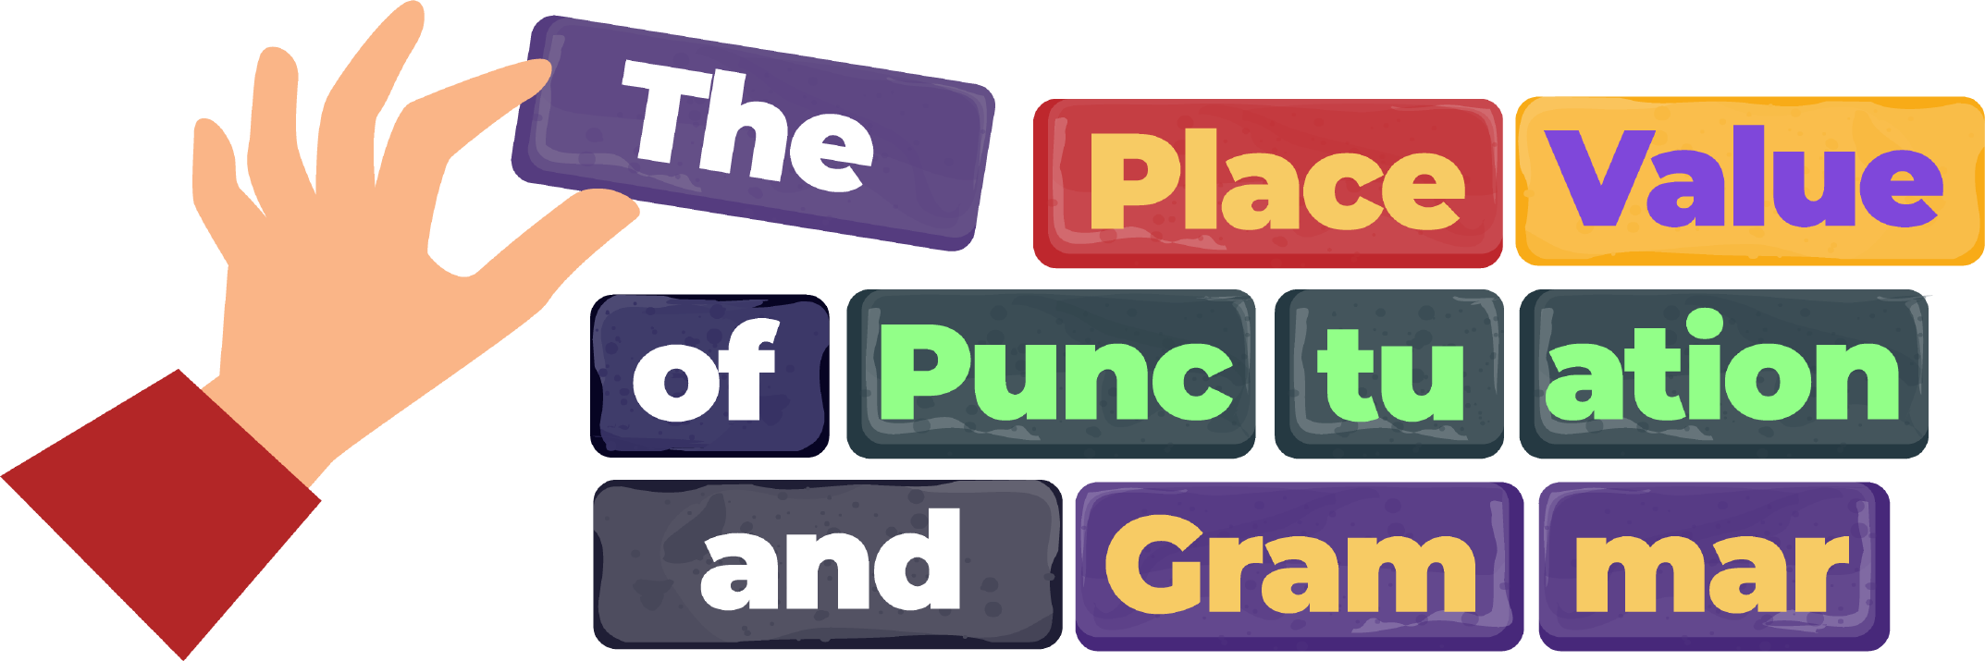








What are common nouns
and proper nouns?
www.grammarsaurus.co.uk

Slide 2


Common nouns
1
A common noun refers to a general person, place or thing.
What does general mean?
The man watched the film.
From this sentence, we do not know who the man is. The man is non-specific.
It is a general man.
Man is a common noun.
From this sentence, we do not know which particular film was watched. The film is non-specific.
It is a general film.
Film is a common noun.
Common nouns do not have capital letters unless they come at the beginning of a sentence.
www.grammarsaurus.co.uk

Slide 3
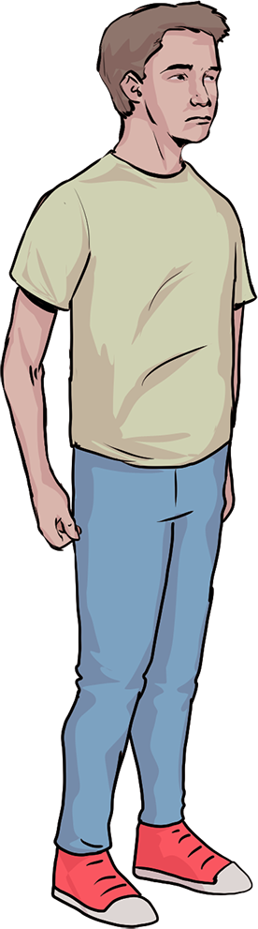
Proper nouns
2
A proper noun refers to a specific person, place or thing. It names a noun precisely.
What does specific mean?
Zac watched Batman.
From this sentence, we know who the man is: Zac!
It is not a general man. It is a specific man.
Zac is this man’s specific name.
Zac is a proper noun.
From this sentence, we know which particular film was watched: Batman!
It is not a general film. It is a specific film.
Batman is this film’s specific name.
Batman is a proper noun.
Proper nouns always have a capital letter.
www.grammarsaurus.co.uk

Slide 4
3
Fluency
Let’s discuss!
Which word belongs where? Discuss with your learning partner.
general proper common specific
A noun refers to a person, place or thing. A noun refers to a person, place or thing.
It names a noun precisely.
Be ready to share your feedback with the class before the answers are revealed.
www.grammarsaurus.co.uk

Slide 5
4
Fluency
Let’s discuss!
answers
Which word belongs where? Discuss with your learning partner.
A common noun refers to a general person, place or thing.
A proper noun refers to a specific person, place or thing.
It names a noun precisely.
www.grammarsaurus.co.uk

Slide 6
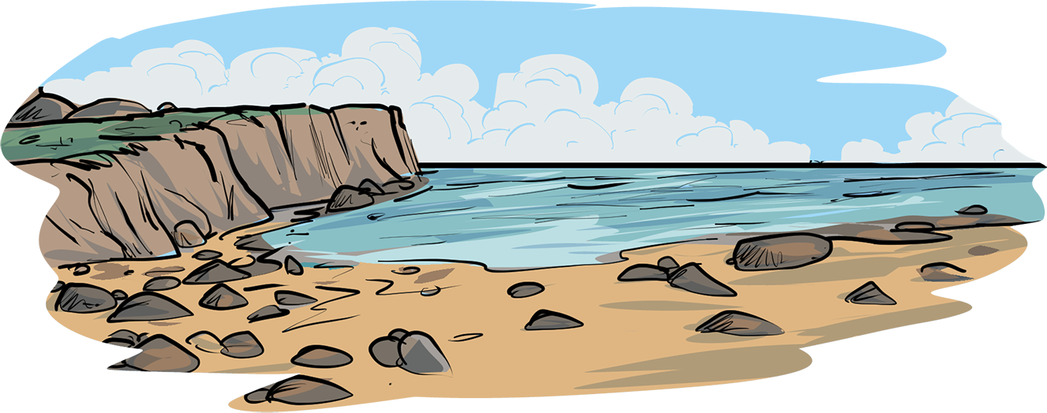
Identifying nouns
5
Is it a person, place or a thing?
Is it a common noun or a proper noun?
Sophia went on holiday to Spain.
YES
NO
Sophia holiday Spain
Has the noun been given a specific name so it can be identified?
It is not a noun.
went on
to
YES NO
It’s a proper noun. It needs a capital letter.
It’s a common noun. It does
not need a
capital letter.
Sophia Spain
holiday
www.grammarsaurus.co.uk

Slide 7
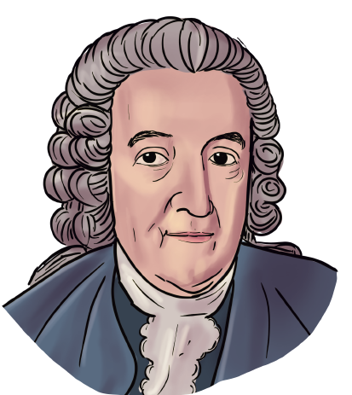
Identifying nouns
6
Fluency
Is it a common noun or a proper noun?
(This time, to help disguise the answers, capital letters have not been used for proper nouns.)
Is it a person, place or a thing?
Carl linnaeus named each organism in latin.
YES
NO
person
thing
thing
(language)
Carl linnaeus named each organism in latin.
Has the noun been given a specific name so it can be identified?
It is not a noun.
YES NO
proper noun
common noun
proper noun
Carl linnaeus named each organism in latin.
It’s a proper noun. It needs a capital letter..
It’s a common
noun. It does
not need a
capital letter.
www.grammarsaurus.co.uk

Slide 8

7
Fluency
Whiteboard activity
Now that we’ve identified the proper nouns in this sentence, write it on your whiteboard with capital letters used correctly.
Is it a person, place or a thing?
Carl linnaeus named each organism in latin.
YES
NO
Has the noun been given a specific name so it can be identified?
It is not a noun.
YES NO
It’s a proper noun. It needs a capital letter..
It’s a common
noun. It does
not need a
capital letter.
www.grammarsaurus.co.uk

Slide 9
8
Fluency
Whiteboard activity
answers
Now that we’ve identified the proper nouns in this sentence, write it on your whiteboard with capital letters used correctly.
Is it a person, place or a thing?
Carl Linnaeus named each organism in Latin.
YES
NO
Has the noun been given a specific name so it can be identified?
It is not a noun.
YES NO
It’s a proper noun. It needs a capital letter..
It’s a common
noun. It does
not need a
capital letter.
www.grammarsaurus.co.uk

Slide 10
Paired activity
9
Fluency
Which are common nouns? Which are proper nouns? Identify them with your learning partner.
(To help disguise the answers, capital letters have not been used for proper nouns.)
Amba watched the show at the london palladium.
Is it a person, place or a thing?
My brother is an electrician in sydney.
YES
NO
The linnaean system divided vertebrates into five groups (mammals, fish, amphibians, birds and reptiles).
Has the noun been given a specific name so it can be identified?
It is not a noun.
YES NO
The swedish scientist studied and lectured at uppsala university.
It’s a proper noun. It needs a
capital letter..
It’s a common
noun. It does
not need a
capital letter.
Be ready to share your feedback with the class before the answers are revealed.
www.grammarsaurus.co.uk

Slide 11
answers
10
Fluency
Paired activity
Which are common nouns? Which are proper nouns? Identify them with your learning partner.
Amba watched the show at the London Palladium.
Is it a person, place or a thing?
My brother is an electrician in Sydney.
YES
NO
The Linnaean system divided vertebrates into five groups
(mammals, fish, amphibians, birds and reptiles).
Has the noun been given a specific name so it can be identified?
It is not a noun.
YES NO
It’s a proper noun. It needs a
capital letter..
It’s a common
noun. It does
not need a
capital letter.
The Swedish scientist studied and lectured at Uppsala University.
www.grammarsaurus.co.uk

Slide 12
Whiteboard activity
11
Fluency
Which sentences use proper nouns? Write their numbers on your whiteboard. (To help disguise the answers, capital letters have not been used for proper nouns.)
On saturday, I went to tariq’s birthday party.
We played on the bouncy castle and ate cake from gregg’s.
It’s summer so the weather was hot!
This scientist wrote a book called system naturae.
The animal kingdom is the largest of five kingdoms.
Snakes, lizards and crocodiles are reptiles.
www.grammarsaurus.co.uk

Slide 13
answers
12
Fluency
Let’s discuss!
How did you know which were proper nouns? Discuss with your learning partner.
1) On Saturday, I went to Tariq’s birthday party.
2) We played on the bouncy castle and ate cake from Gregg’s.
3) It’s summer so the weather was hot!
The animal kingdom is the largest of five kingdoms.
Snakes, lizards and crocodiles are reptiles.
4) This scientist wrote a book called System Naturae.
Be ready to share your feedback with the class.

Slide 14
13
Reasoning
Whiteboard activity
Draw this grid on your whiteboard.
Replace the proper nouns with common nouns and the common nouns with proper nouns.
city month Tesco
continent
Fortnite
teacher
Beyonce
Monday
www.grammarsaurus.co.uk

Slide 15

Let’s discuss!
14
Reasoning
Discuss your answers with a partner. What’s the same? What’s different? Why?
Have you used a capital letter for each proper noun?
city month Tesco
continent
Fortnite teacher Beyonce Monday
Be ready to feedback to the class. How many different answers were there?
www.grammarsaurus.co.uk

Slide 16
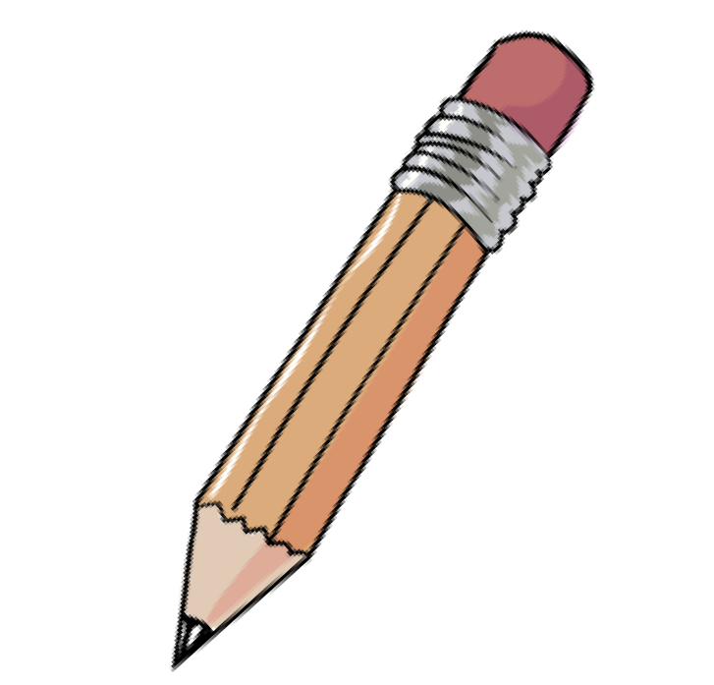
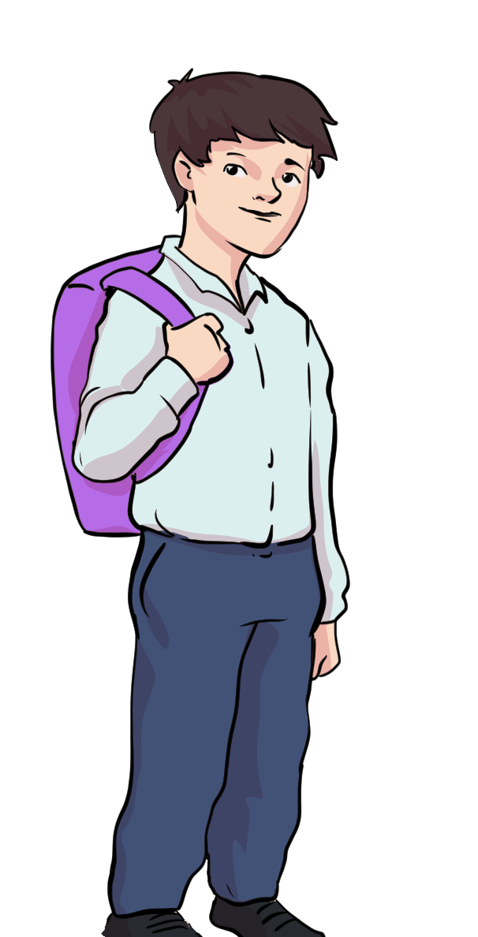
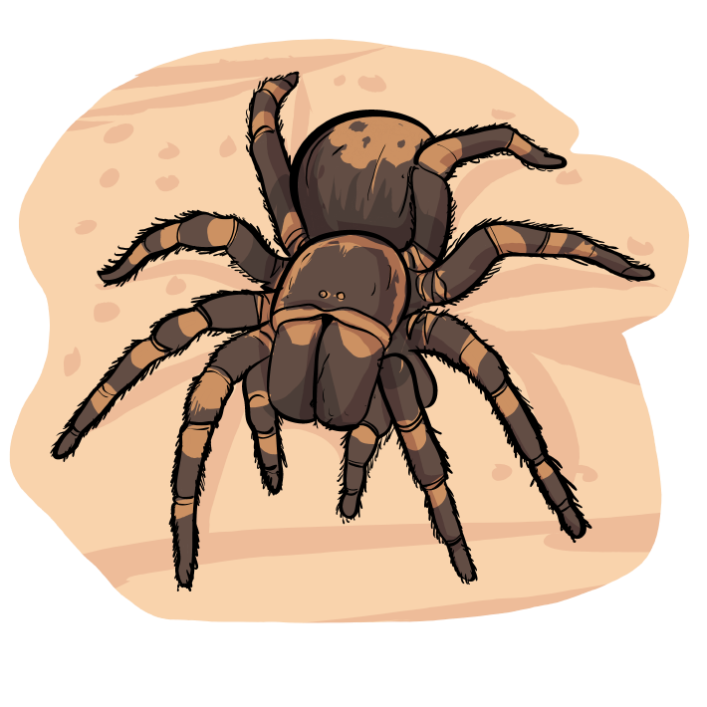
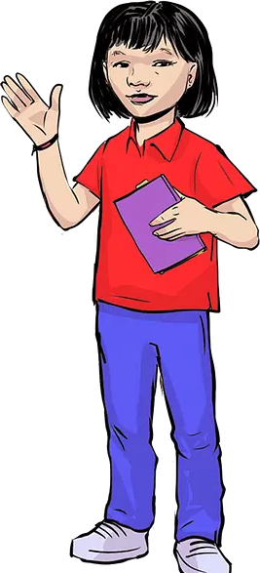
15
Reasoning
Whiteboard activity
Who is correct? Write the answer on your whiteboard.
A Tarantula is an arthropod. A tarantula is an arthropod.
Ivan
Sami
I think that ‘Tarantula’ is a proper noun because it’s the name of a spider. It does need a capital letter.
I think that ‘tarantula’ is a common noun.
It does not need a capital letter.
www.grammarsaurus.co.uk

Slide 17
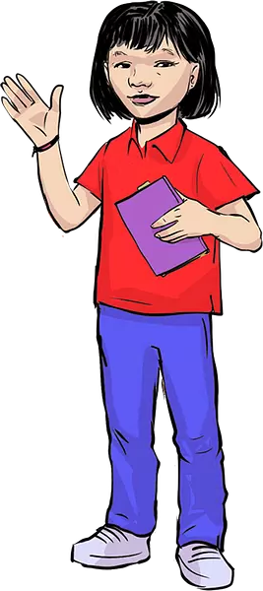
Let’s discuss!
16
Reasoning
Why is Sami correct?
A tarantula is an arthropod.
Discuss your answer with a partner.
I think that ‘tarantula’
is a common noun. It does not need a capital letter.
In this sentence, tarantula is a . I know this because .
(You may wish to use the words general and/or specific in your explanation.)
Be ready to share your feedback with the class before the explanation is revealed.
www.grammarsaurus.co.uk

Slide 18
Let’s discuss!
17
Reasoning
answers
Why is Sami correct?
A tarantula is an arthropod.
In this sentence, tarantula is a common noun .
I know this because it is not the name of a specific tarantula.
It is referring to a general category known as ‘tarantula’.
I think that ‘tarantula’
is a common noun. It does not need a capital letter.
www.grammarsaurus.co.uk

Slide 19
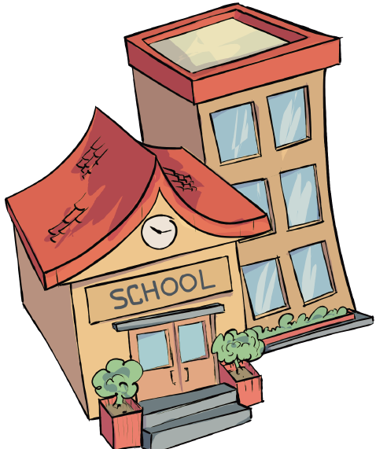
Common and proper nouns
18
Some words can be used as both common nouns and proper nouns like in the sentences below:
It was playtime at the school.
In this sentence, school is a common noun. It does not need a capital letter. We do not know from this sentence which specific school was having their playtime. It is referring to a general school.
Is it a person, place or a thing?
YES
NO
It was playtime at Tree Primary School.
Has the noun been given a specific name so it can be identified?
It is not a noun.
In this sentence, School is a proper noun. It needs a capital letter. We know which school was having their playtime: Tree Primary School! It is a specific school.
Tree Primary School is its specific name.
YES NO
It’s a proper noun. It needs a
capital letter..
It’s a common
noun. It does
not need a
capital letter.
www.grammarsaurus.co.uk

Slide 20
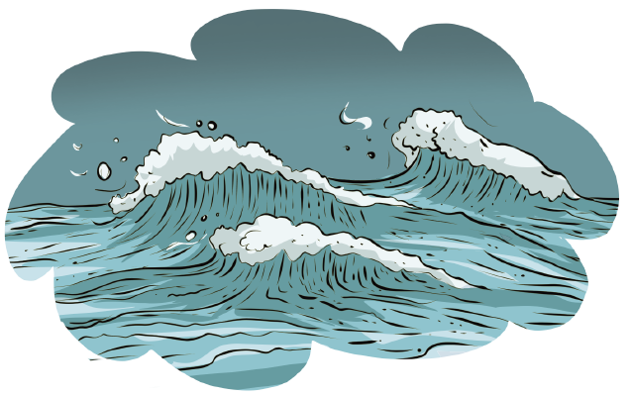
Let’s discuss!
19
Reasoning
In this sentence, the word ‘ocean’ is used twice.
The Atlantic Ocean is the second
Is it a person, place or a thing?
largest ocean in the world.
YES
NO
Has the noun been given a specific name so it can be identified?
It is not a noun.
How is ocean used differently each time? Discuss with your partner.
YES NO
It’s a proper noun. It needs a
capital letter..
It’s a common
noun. It does
not need a
capital letter.
In the first sentence, Ocean is a . I know this because . In the first sentence, ocean is a . I know this because .
Be ready to share your feedback with the class before the answer is revealed.
(You may wish to use the words general and/or specific in your explanation.)
www.grammarsaurus.co.uk

Slide 21
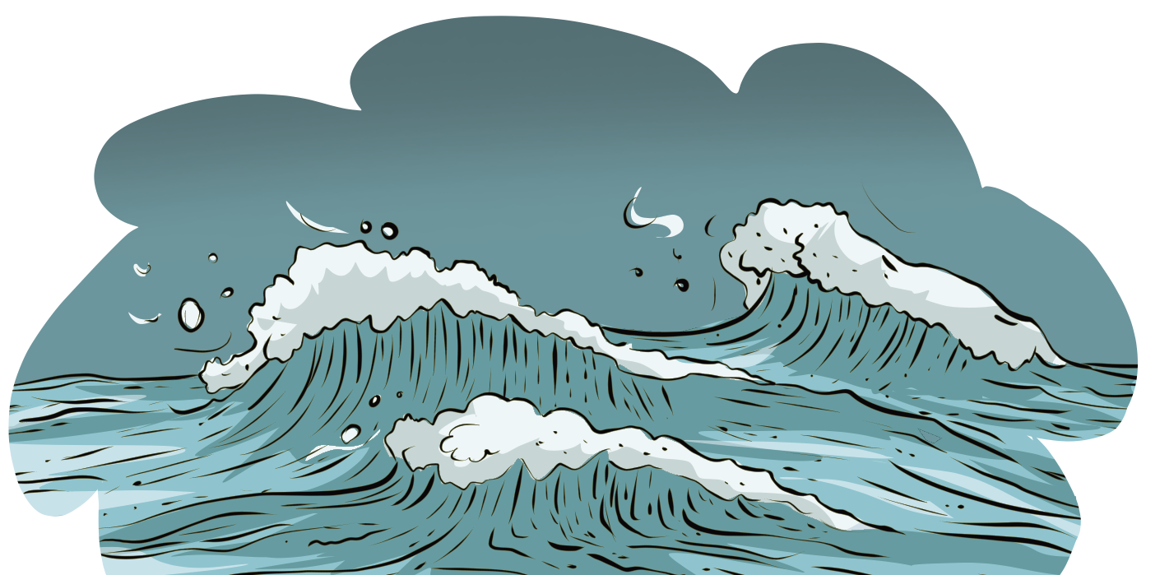
Let’s discuss!
20
Reasoning
answers
In this sentence, the word ‘ocean’ is used twice.
The first Ocean is a proper noun. I know this because it is the specific name of a specific ocean.
Is it a person, place or a thing?
The Atlantic Ocean is the second largest
ocean in the world.
YES
NO
Has the noun been given a specific name so it can be identified?
It is not a noun.
The second ocean is a common noun. I know this because it is not the name of a specific
ocean. It is referring to a general category known as ‘ocean’.
YES NO
It’s a proper noun. It needs a
capital letter..
It’s a common
noun. It does
not need a
capital letter.
www.grammarsaurus.co.uk

Slide 22
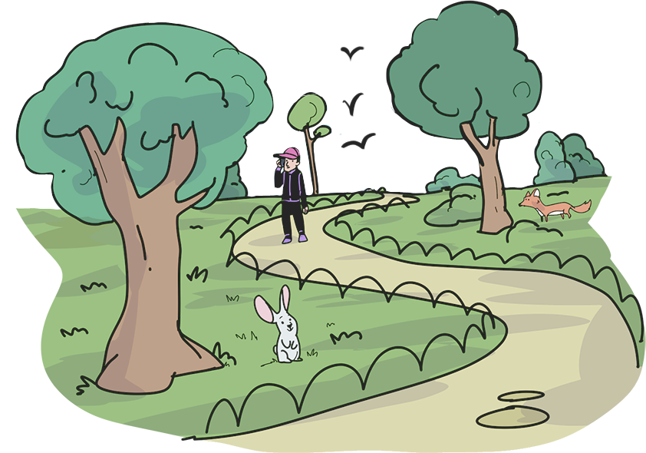
21
Reasoning
Whiteboard activity
Write a sentence on your whiteboard using PARK as a common noun.
Write a second sentence on your whiteboard using PARK as a proper noun.
www.grammarsaurus.co.uk

Slide 23
answers
22
Reasoning
Whiteboard activity
Write a sentence on your whiteboard using PARK as a common noun.
Write a second sentence on your whiteboard using PARK as a proper noun.
I’m going to meet my friends in the park.
In this sentence, park is a common noun. It does not need a capital letter. We do not know from this sentence which specific park is being referred to. It is referring to a general park.
I’m going to meet my friends in Castle Park.
In this sentence, Park is a proper noun. It needs a capital letter. We know which park is being referred to: Castle Park! It is a specific park. Castle Park is its specific name.
www.grammarsaurus.co.uk

Slide 24
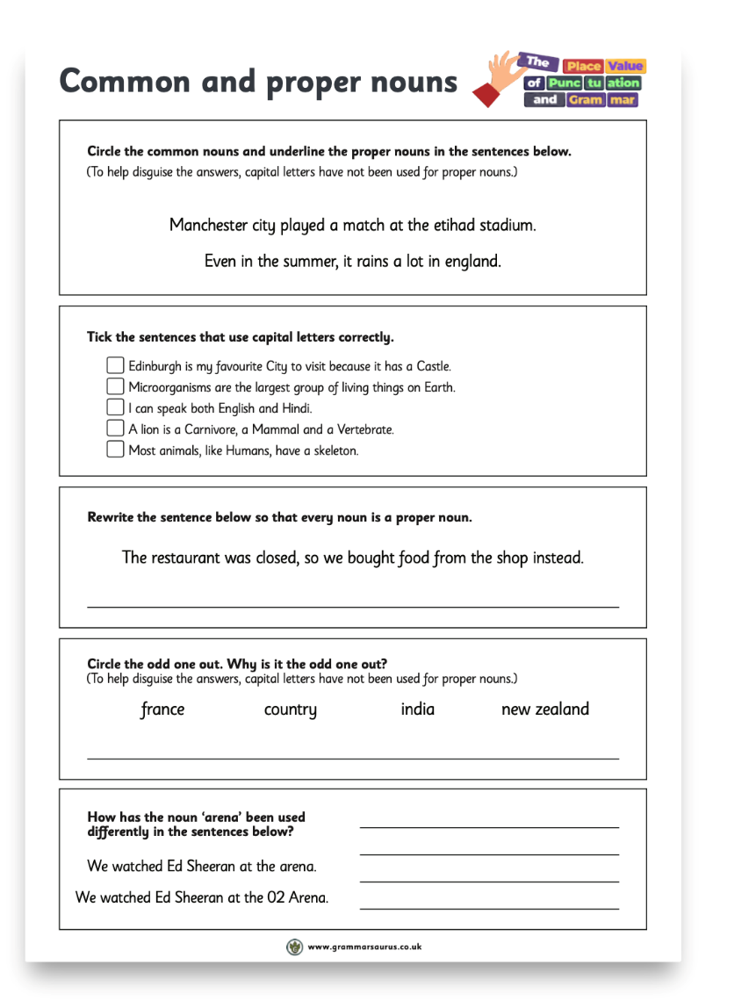


Independent Activity
23
Answer the questions on the worksheet.
Common and proper nouns
Circle the common nouns and underline the proper nouns in the sentences below.
(To help disguise the answers, capital letters have not been used for proper nouns.)
Taylor swift sang a song on stage at the utilita arena in birmingham.
The sun is a star that orbits earth.
Tick the sentences that use capital letters correctly.
Sports day is my favourite Day of the year at school. Last year, Tyrone came in first place in every race! Pluto was deemed too small to be a planet.
Every planet orbits the sun, which sits in the centre. The third closest planet to the Sun is Earth.
Rewrite the sentence below so that every noun is a proper noun.
My console is broken, so I can’t play the game.
Circle the odd one out. Why is it the odd one out?
planet pluto neptune
mercury
How has the noun ‘hotel’ been used differently in the sentences below?
We stayed at a hotel.
We stayed at Hotel Gotham.
www.grammarsaurus.co.uk
www.grammarsaurus.co.uk

Slide 25
24
Reasoning
Challenge
True or false?
Job titles (e.g., teacher, doctor) never need capital letters.
Explain your answer.
Job titles (always/sometimes/never)
need capital letters because .
(Use an example sentence or sentences in your answer that prove your explanation.)
www.grammarsaurus.co.uk

Slide 26
25
Reasoning
Challenge
answers
True or false?
Job titles (e.g., teacher, doctor) never need capital letters.
False
Job titles sometimes need capital letters because sometimes they are common nouns and
sometimes they are proper nouns.
e.g. Doctor Smed prescribed some antibiotics.
In this sentence, Doctor is a proper noun because it is the name of a specific doctor: Doctor Smed.
e.g. I was poorly, so I went to see the doctor.
In this sentence, doctor is a common noun because it is not the name of a specific doctor. It is referring to a general category known as ‘doctor’.
www.grammarsaurus.co.uk

