Slide 1
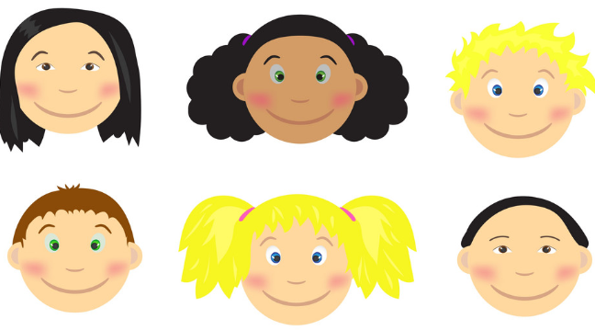
Art
- Draw/paint a self portrait
- Create a coat of arms that represents things that are special to you
- Graffiti Art of your name – make it unique to you
History
Can you create a family tree?
Can you create a timeline of important events in your life? For example the year you started school? Moving house? Etc.
Geography
Locate on map where you were born – Can you find out 10 facts about that place
Where were members of your family born? Find these on a map as well. How near or far are they away from where you were born?
- List all the places you have visited in the UK and abroad. Can you list your top five places?
PE
What is your favourite sport or activity? Can you take a photo or video of yourself doing this?
- Which sporting person do you admire? Record 5 things that you admire about them.
Me, Myself and I.
What makes me Unique?
PSHE
What makes you an amazing person? Record all your unique qualities
Future career – what do you want to be when you are older – think about the skills you need to do this
My Five wishes – If you were granted five wishes what would they be and why?
English
Write a story about a funny/important day in your life
Record a diary entry about your best ever day at Wyburns. It could be a sports day/trip/brilliance
Create a Non – Chronological all about you. Be creative with your headings
Click this
Being unique is awesome

