Slide 1

Year 3 and 4
HOME
FITNESS CIRCUIT
In the following power point
there are a range of exercises you can do at home.

Slide 2
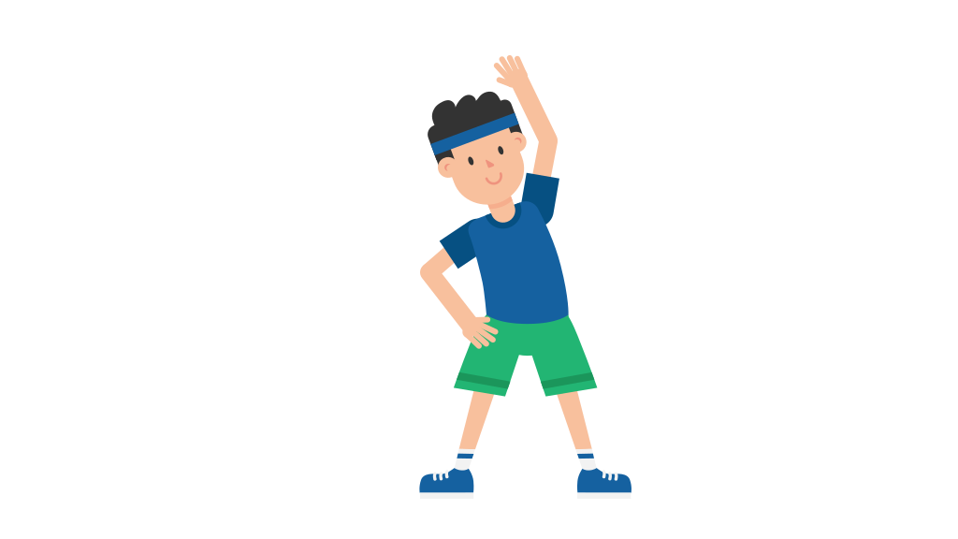
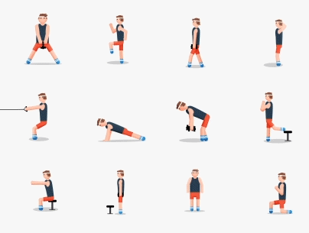
HOME FITNESS CIRCUIT
The aim of the circuit is to:
Help you get some exercise
Maintain and improve your fitness levels

Slide 3
HOME FITNESS CIRCUIT
The Circuit
Shuttle runs
Press ups
Jumping jacks/Star jumps
Burpees
Skipping
Step ups

Slide 4
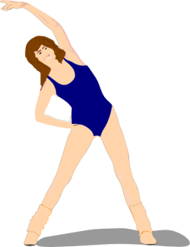
HOME FITNESS CIRCUIT
How to do the circuit
1.Put on your favourite music
2. Warm up: Jog on the spot for 60 – 90 seconds.
Then carry out dynamic (moving) stretches
3. Spend 20 seconds exercising at each station and complete the circuit in the correct order
4. After completing all stations rest for 2 minutes. If you want to, repeat the circuit once, or even twice.

Slide 5

Year 3 and 4
HOME FITNESS CIRCUIT
It’s your choice whether you wish to record the scores or not.
If you decide to record your scores, you could see if you get better over the weeks or even compare them with friends and discuss what has gone well and how you could improve.

Slide 6
HOME FITNESS CIRCUIT
Music on
Water nearby
Then go!

Slide 7
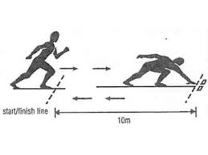
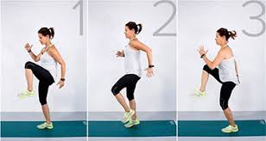
Cardiovascular Endurance
Muscular Endurance
1. Shuttle runs
Or
Running on the spot
Key Points
- Run between two markers
Use your arms to drive forward/keep balance.
- Touch the markers each time
Easy: Jog slowly.
Harder: Run fast.
Insane: Sprint!

Slide 8
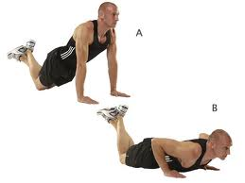
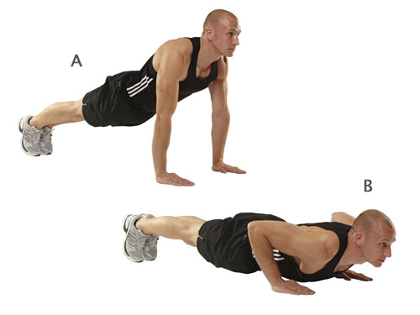
Triceps
Pectorals
2. Press Ups
Key Points
Straight back.
Bend elbows and lower chest to the floor.
Push back up to starting position
Select your level
Easy: Box - Start on your knees.
Medium: Picture A lean forward on your knees.
Hard: Full press up

Slide 9

Cardiovascular Endurance
Muscular Endurance
3. Jumping Jacks
Key Points
Stand upright with your legs together, arms at your sides.
Bend your knees slightly, and jump into the air.
As you jump, spread your legs to be about shoulder-width apart.
Stretch your arms out and over your head.
Jump back to starting position.
Repeat.
Easy: Slowly.
Harder: Bit quicker.
Insane: Fast!

Slide 10
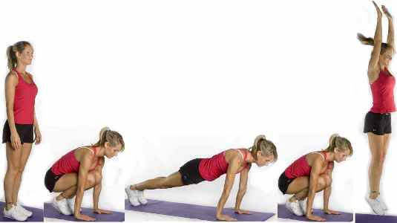
Cardiovascular Fitness
4. Burpees
Full Body
Key Points
Squat down.
Kick feet back.
Chest to floor.
Return to squat position.
Jump!
Easy – miss out kick feet back
Harder - Add a press up!

Slide 11
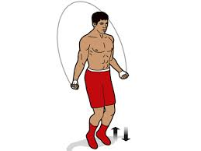
Cardiovascular Endurance
Muscular Endurance
5. Skipping
Key Points
Hold the skipping rope by the handles.
Start with your hands in front of your body but the rope behind, throw the rope over your head and jump just as the rope hits the floor.
Try maintain a rhythm for this one!
NO SKIPPING ROPE
Pretend you have one!
Jump forwards and back
Bring your knees up and down

Slide 12
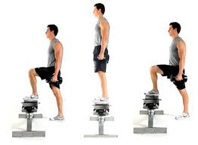
Cardiovascular Endurance
Muscular Endurance
6. Step Ups
Key Points
Head up and a straight back at all times.
Step onto the a small bench or first stair (make sure your whole foot goes on the bench).
Then step off the bench one foot at a time.
Easier – do a step pattern on the floor.
Medium – add arm actions up and down
Harder – add a burpee on the floor!

Slide 13
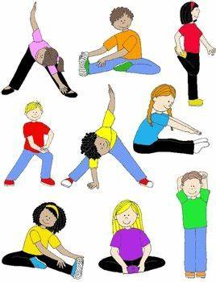
Year 3 and 4
HOME FITNESS CIRCUIT
Now rest for 2 minutes or
do another circuit or carry out a
cool down
See next slide for cool down information

Slide 14
Cool Down
Do the static stretches shown in the next slide.
Hold each stretch for 30 seconds each.

Slide 15
