Slide 1
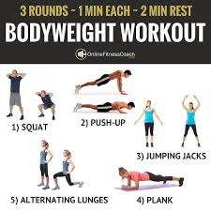
PHYSICAL EDUCATION
HOME FITNESS CIRCUIT

Slide 2
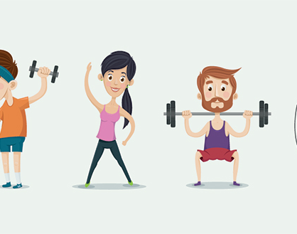
HOME
FITNESS CIRCUIT
In the following power point
there are a range of exercises you can do at home.

Slide 3
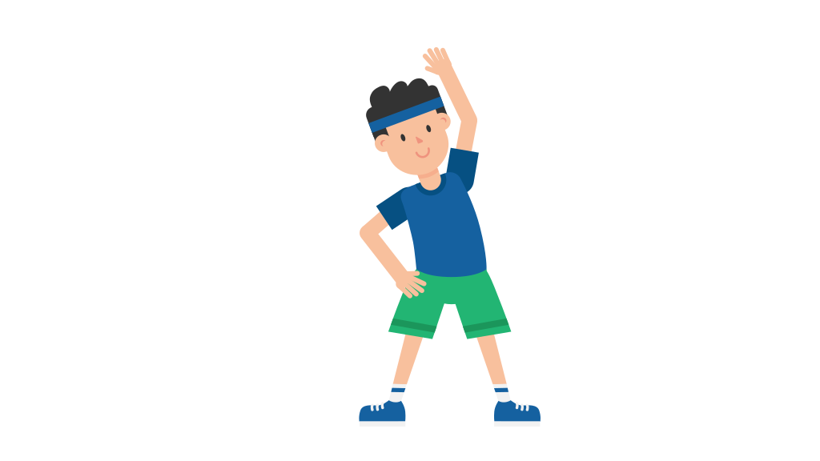
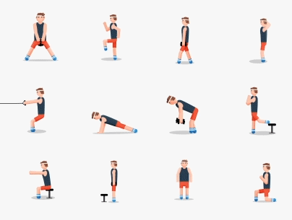
HOME FITNESS CIRCUIT
The aim of the circuit is to:
Help you get some exercise
Maintain & Improve your fitness levels

Slide 4
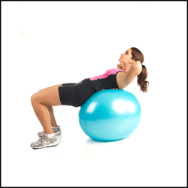
HOME FITNESS CIRCUIT
The Circuit
Mountain climbers
Press ups
Squats
Abdominal crunches
Jumping jacks
Triceps dips
Burpees
Press up shoulder tap

Slide 5
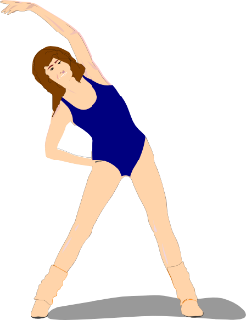
HOME FITNESS CIRCUIT
How to do the circuit
1. Put on your favourite music
2. Warm up: Jog on the spot for 60 – 90 seconds.
Then carry out stretches (hold stretches for 10 secs)
(See slide no. 35)
3. Spend 45 seconds exercising at each station
(45 seconds rest to give time to record score)
and complete the circuit in the correct order
(6 minutes of exercise)
4. Rest for 2 minutes

Slide 6
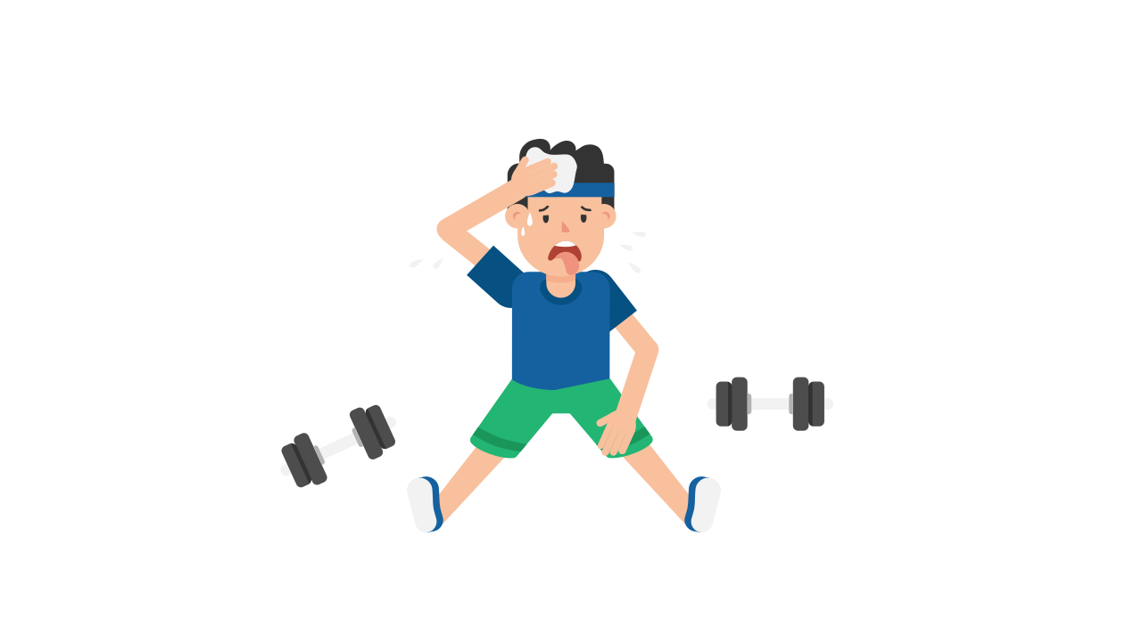
HOME FITNESS CIRCUIT
How to do the circuit (Continued)
Repeat the circuit for a 2nd time
(12 minutes of exercise)
7. Rest again for 2 minutes
Repeat Circuit for 3rd time
(18 minutes of exercise)
9. Cool down
10. Finish and relax

Slide 7
HOME FITNESS CIRCUIT
How do I get fitter?
Each week we will reduce the rest time between circuits by 10 seconds
Week 1: 2 minutes rest between sets
Week 2: 1 minute 50 seconds rest between sets
Week 3: 1 minute 40 seconds rest between sets
(Ideally you should do this circuit three times a week)

Slide 8

Year 5 and 6
HOME FITNESS CIRCUIT
Try to record your scores, so you can see if you improve.
You could compare your scores with friends and discuss what has gone well and how you could improve.

Slide 9
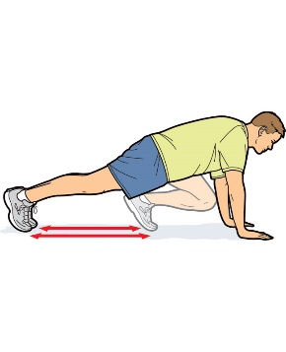
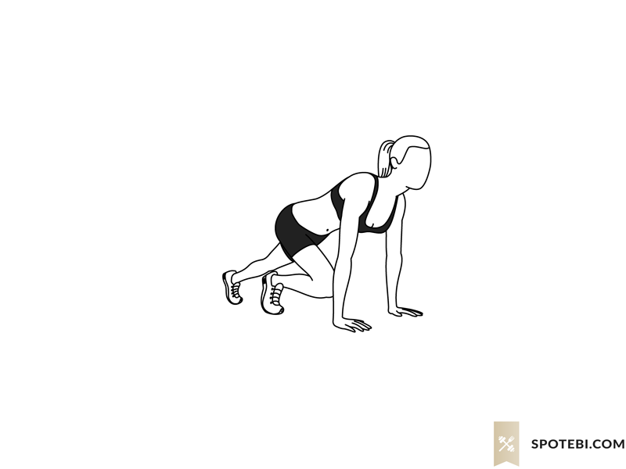
HOME FITNESS CIRCUIT
Get ready to exercise for 45 seconds…
Exercise 1:
Mountain climbers

Slide 10
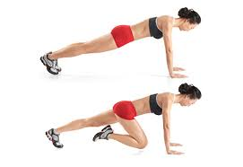
Cardiovascular Fitness
Muscular Endurance
1. Mountain Climbers
Key Points
Begin in the press up position.
Straight back at all times.
Drive knee to the chest (one leg at a time).
This can be performed with hands on a bench.
Progressions!
1) Single leg out to the side.
2) Rotate single leg in a circular motion (then swop!)

Slide 11
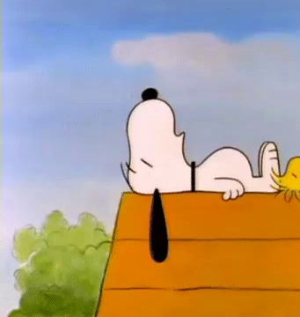
HOME FITNESS CIRCUIT
Well done!!
Now rest for
45 seconds &
record your score…

Slide 12
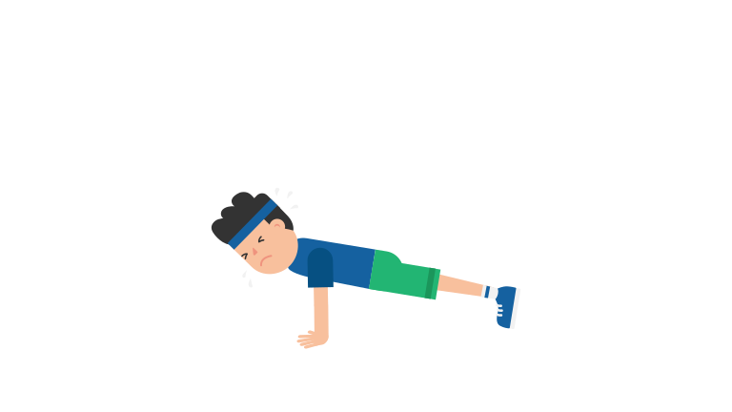
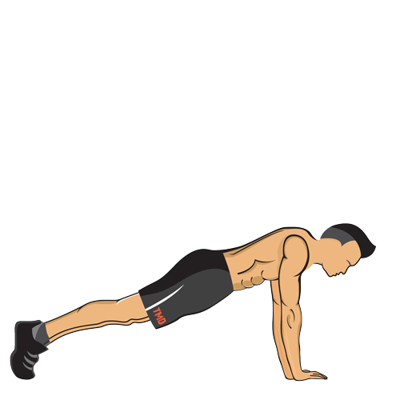
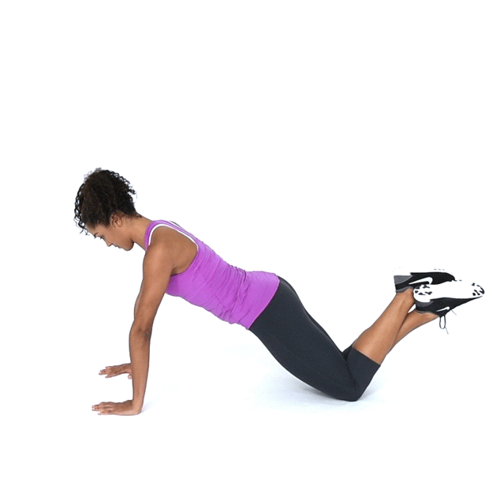
HOME FITNESS CIRCUIT
Get ready to exercise for 45 seconds…
Exercise 2:
Press ups

Slide 13
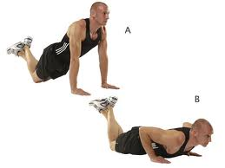
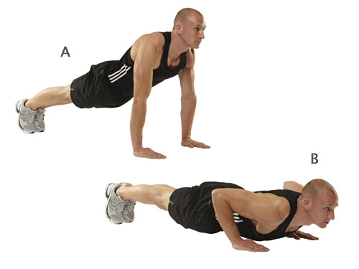
Triceps
Pectorals
2. Press Ups
Key Points
- Head facing forward.
Straight back.
Bend elbows and lower chest to the floor.
Push back up to starting position.
Easy: Start from knees.
Harder: Start from feet.
Insane: Press up with front clap!

Slide 14
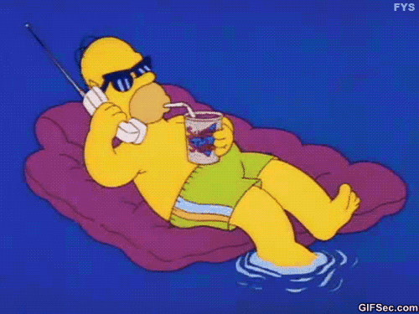
HOME FITNESS CIRCUIT
Good job!!
Now rest for
45 seconds &
record your score…

Slide 15
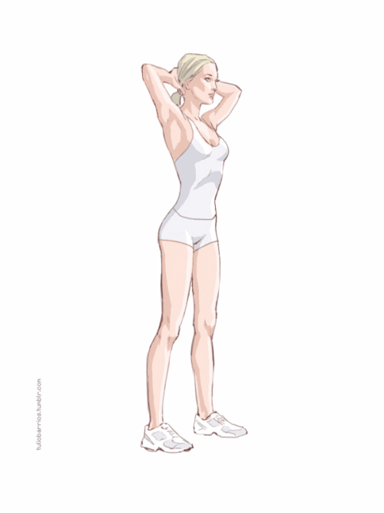
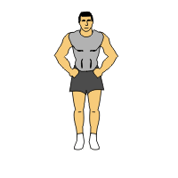
HOME FITNESS CIRCUIT
Get ready to exercise for 45 seconds…
Exercise 3:
Squats

Slide 16
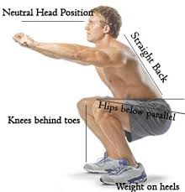
Quadriceps
Gluteus Maximus
3. Squats
Key Points
- Neutral head position
Straight back.
Hips parallel or below!
Knees behind toes.
Weight on heels.
Progression!
Easy: Squat onto a chair.
Harder: Squat on your own –as in diagram.
Insane: squat on one leg!

Slide 17

HOME FITNESS CIRCUIT
Great work!!
Now rest for
45 seconds &
record your score…

Slide 18
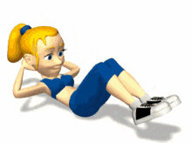
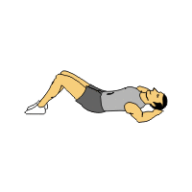
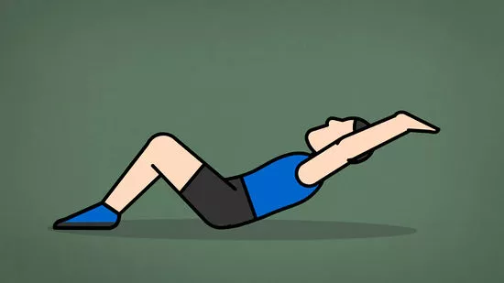
HOME FITNESS CIRCUIT
Get ready to exercise for 45 seconds…
Exercise 4:
Ab crunches

Slide 19
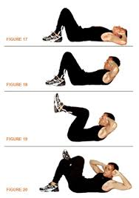
Abdominals
Hip Flexors
4. Ab Crunches
Key Points
Raise knees and fixate hips.
Raise shoulders off the floor (only go half way!)
Lower shoulders back to the floor and repeat!
Hands on ears or across chest, NOT behind neck
Progressions
1) Raise legs to 90 degrees whilst performing the sit up.
2) Place one leg across the other and add a twist in the sit up.
1
2

Slide 20

HOME FITNESS CIRCUIT
Excellent work!
Now rest for
45 seconds & record your score…

Slide 21
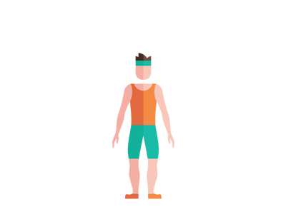
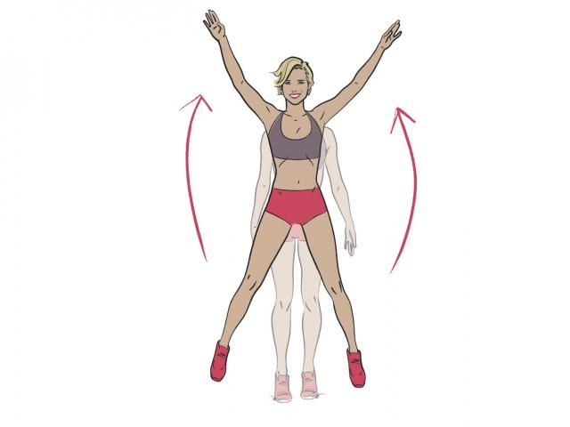
HOME FITNESS CIRCUIT
Get ready to exercise for 45 seconds…
Exercise 5:
Jumping Jacks

Slide 22
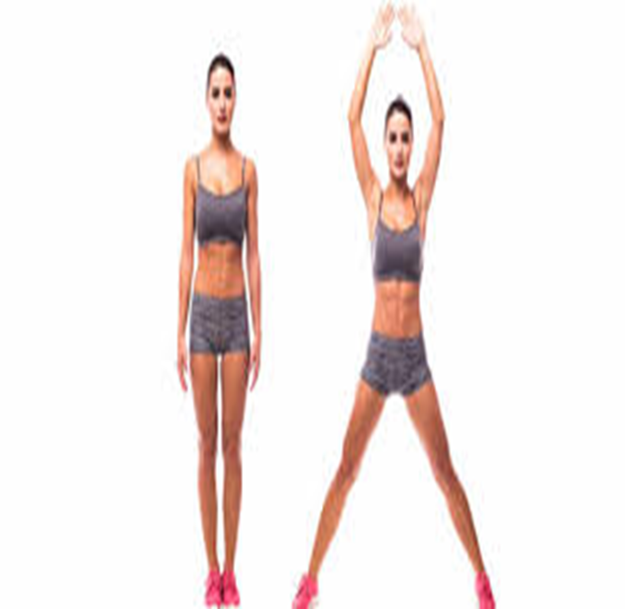
Cardiovascular Endurance
Muscular Endurance
5. Jumping Jacks
Key Points
Stand upright with your legs together, arms at your sides.
Bend your knees slightly, and jump into the air.
As you jump, spread your legs to be about shoulder-width apart.
Stretch your arms out and over your head.
Jump back to starting position.
Repeat.
Easy: Slowly.
Harder: Bit quicker.
Insane: Fast!

Slide 23
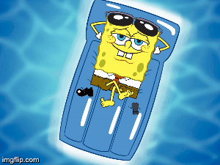
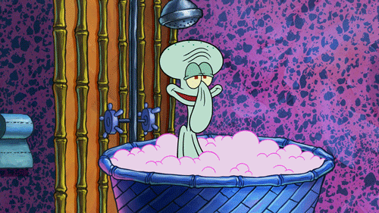
HOME FITNESS CIRCUIT
Fantastic!!
Now rest for 45 seconds & record your score…

Slide 24
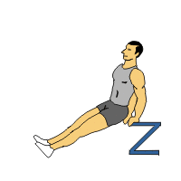
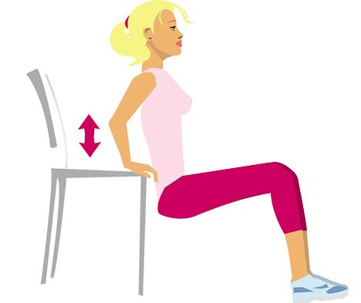
HOME FITNESS CIRCUIT
Get ready to exercise for 45 seconds…
Exercise 6:
Triceps dips

Slide 25
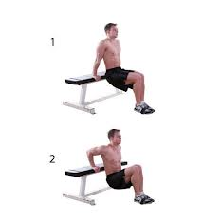
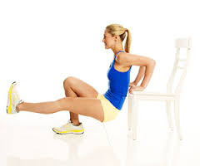
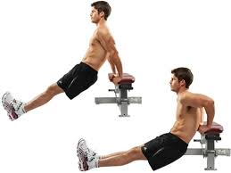
Triceps
Pectorals
6. Triceps Dips
Key Points
Place hands on bench with fingers facing forwards.
Straighten legs so only heels are touching the floor.
Bend elbows to lower buttocks to the floor.
Push back up so elbows are straight.
1
3
2
No. 1 = Easy
No. 2 = Hard
No. 3 = Insane!

Slide 26
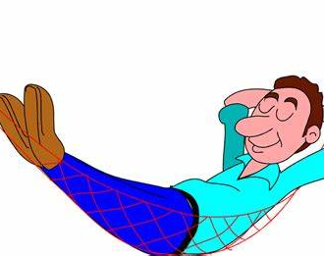
HOME FITNESS CIRCUIT
Great job!!
Now rest for
45 seconds & record your score

Slide 27
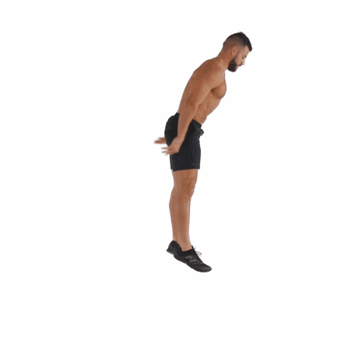
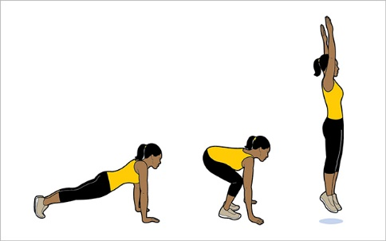
HOME FITNESS CIRCUIT
Get ready to exercise for
45 seconds…
Exercise 7:
Burpees

Slide 28
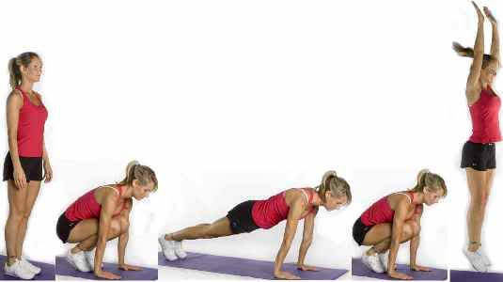
Cardiovascular Fitness
7. Burpees
Full Body
Key Points
Squat down.
Kick feet back.
Chest to floor.
Return to squat position.
Jump!
Progression!
Add a press up!
Do this on a crash mat!

Slide 29
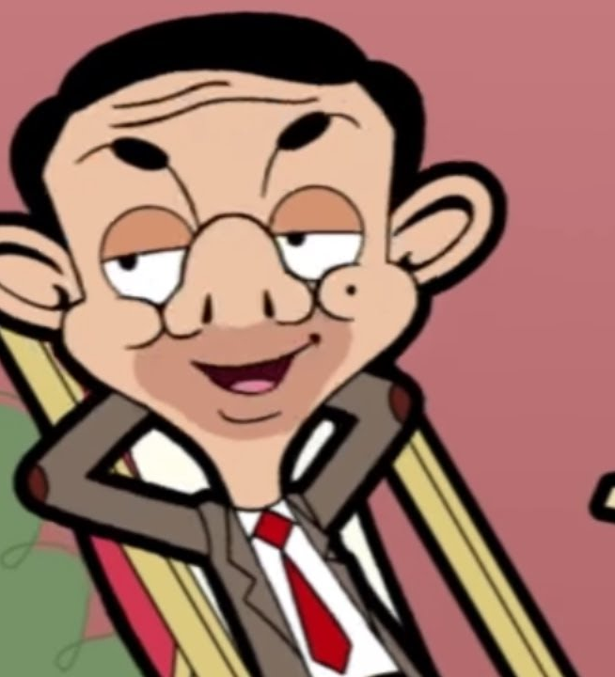
HOME FITNESS CIRCUIT
Your doing really well…
Now rest for
45 seconds &
record your score…

Slide 30
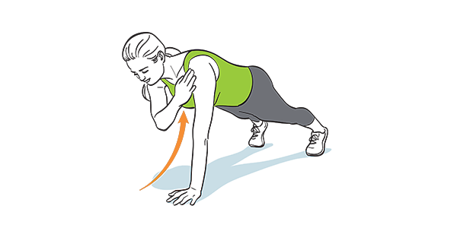
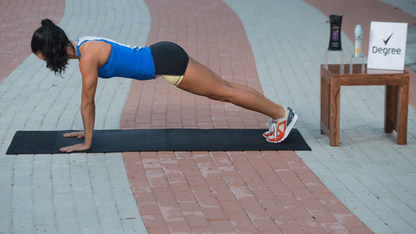
HOME FITNESS CIRCUIT
Get ready to exercise for 45 seconds…
Exercise 8:
Press up shoulder tap

Slide 31
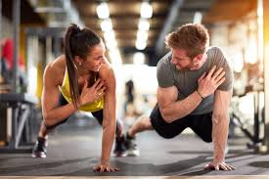
Abdominals
Lower Back
8. Press up shoulder tap
Key Points
Set up in a press up position
Slowly lift one hand and tap your shoulder
Put your hand back down
Repeat on the other side.

Slide 32

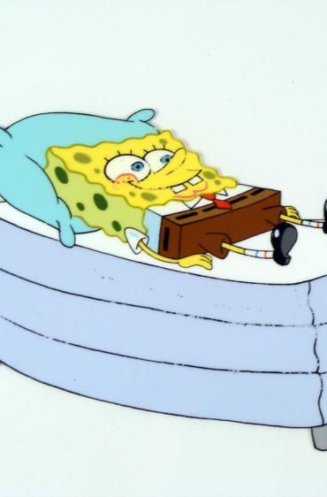
HOME FITNESS CIRCUIT
Well done,
your doing a fab job…
Now rest for
2 minutes, record your score and drink some water

Slide 33
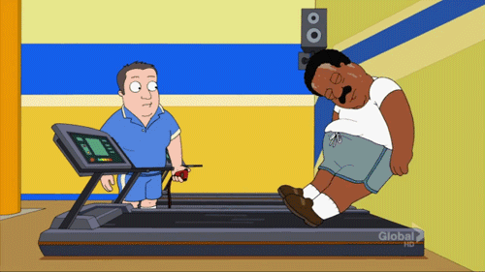
HOME FITNESS CIRCUIT
Now repeat the circuit
2
more times

Slide 34
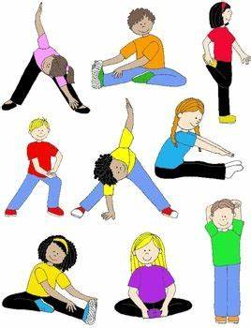
HOME FITNESS CIRCUIT
Now drink some water and carry out a
cool down
See next slides for cool down information

Slide 35
Cool Down
Follow cool down on video
or
Try some of the exercises on the next slide – hold each stretch for 10 seconds
https://www.youtube.com/watch?v=u5Hr3rNUZ24

Slide 36
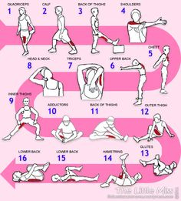

Slide 37
Home Fitness Circuit
Some different exercises
to swap in later…

Slide 38
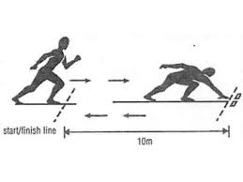
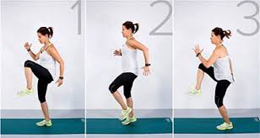
Cardiovascular Endurance
Muscular Endurance
Shuttle runs
Or
Running on the spot
Key Points
- Head up facing forward.
Use your arms to drive forward/keep balance.
Push off your toes.
Easy: Jog slowly.
Harder: Run fast.
Insane: Sprint!

Slide 39
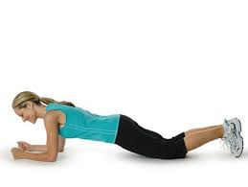
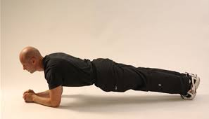

Lower Back
Plank
Abdominals
Key Points
Lay on your front and place your forearms and palms flat on the floor.
Lift your chest, stomach and legs off the floor and maintain balance on forearms and toes.
Keep a straight, flat back.
1.
2.
No. 1 = Easy
No 2 = Hard!
No 3 = Insane!!
3.

Slide 40

Gluteus Maximus
Lunges
Quadriceps
Key Points
Keep back straight.
Shoulders back.
Head facing forward.
Step forward with one leg.
Bend back leg to 90 degrees.
Progression!
Alternate Jump Lunges!

Slide 41



Abdominals
Oblique's
Side Plank
Key Points
- Lay on your side and place forearm 90 degrees on the floor.
Lift your upper body supported either by feet or knees.
Keep body straight and stable.
1 = Easy
2 = Hard
3 = Insane
Further Progression!
Twist free arm underneath the body!

Slide 42

Cardiovascular Endurance
Muscular Endurance
Step Ups
Key Points
Head up and a straight back at all times.
Step onto the bench (make sure both feet go on the bench).
Then step off the bench one foot at a time.
Do this as fast as you can!
Progressions!
Have weights in each hand.
Toe taps on the bench.

Slide 43

Cardiovascular Endurance
Muscular Endurance
Wall Sit
Key Points
90 angle at the knee.
Feet shoulders width apart.
Arms out in front of chest.
Back straight against the wall.

Slide 44

Cardiovascular Endurance
Muscular Endurance
Skipping
Key Points
Hold the skipping rope by the handles.
Start with your hands in front of your body but the rope behind your feet.
Throw the rope over your head and jump just as the rope hits the floor.
Try maintain a rhythm for this one!

