Slide 1

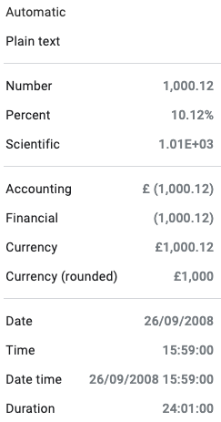
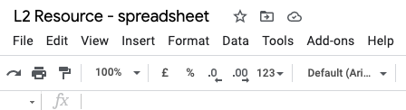
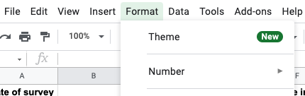
Year 6 -Introducing spreadsheets Lesson 2 – Formatting a spreadsheet | Handout
Applying formats
Select the cells you want to format, then follow the steps below.
1
Click on ‘format’
3
Choose a format from the list
2
Hover over ‘Number’
Resources are updated regularly — the latest version is available at: ncce.io/tcc.
This resource is licensed under the Open Government Licence, version 3. For more information on this licence, see ncce.io/ogl.
Notes:
Last updated: 08-02-22

