Slide 1
Lesson 2: Formatting a spreadsheet
Year 6 – Data and information – Introduction to spreadsheets
Notes:
Last updated: 08-02-22
Resources are updated regularly — the latest version is available at: ncce.io/tcc.
This resource is licensed under the Open Government Licence, version 3. For more information on this licence, see ncce.io/ogl.

Slide 2
Lesson 2: Formatting a spreadsheet
Objectives
To build a data set in a spreadsheet
I can explain what an item of data is
I can choose an appropriate format for a cell
I can apply an appropriate format to a cell

Slide 3
Cell references
Introduction
 | A | B
1 | Name | Number of days off
2 | Reina | 10
3 | David | 13
4 | Yiannis | 1
5 | Bob | 5
6 | Amin | 9
Each box that makes up a table in a spreadsheet is called a cell.
Notes:
Tell the learners that each of the boxes that make up a table in a spreadsheet is called a cell.

Slide 4
Cell references
Introduction
Each cell has a unique cell reference. This allows you to say where a particular piece of data is held.
You can find out a cell reference by using the letters along the top of the table and the numbers down the left-hand side.
 | A | B
1 | Name | Number of days off
2 | Reina | 10
3 | David | 13
4 | Yiannis | 1
5 | Bob | 5
6 | Amin | 9
Notes:
Inform the learners that each of the cells have a unique cell reference.
This allows you to say where a particular piece of data is held.

Slide 5
Cell references
Introduction
 | A | B
1 | Name | Number of days off
2 | Reina | 10
3 | David | 13
4 | Yiannis | 1
5 | Bob | 5
6 | Amin | 9
The word ‘Name’ is in cell A1.
Notes:
Demonstrate that the word ‘Name’ is in cell A1.

Slide 6
What is a data item?
Activity 1
Have a look at this part of a spreadsheet.
What is in cell A2?
What is in cell B5?
What is in cell C3?
What is in cell B1?
What do you notice?
 | A | B | C
1 | Product | Quantity | Cost
2 | Apples | 3 | £1.59
3 | Bananas | 4 | £1.10
4 | Oranges | 1 | £0.60
5 | Lemons | 6 | £1.80
Each cell contains one item of data. There can be many types of data items.

Slide 7
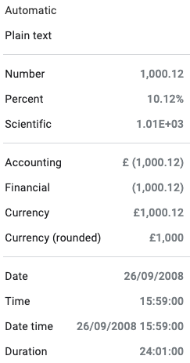
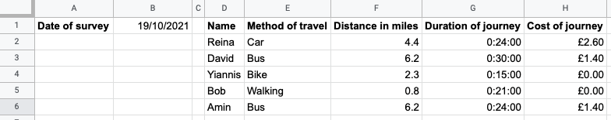
Which format?
Activity 2
The common formats for spreadsheets are shown here.
On your activity sheet, mark which formats have been used on the table below.

Slide 8
Which format? Answers
Activity 2
Duration
Plain text
Date
Number
Currency

Slide 9
Create your own data set and apply formatting
Activity 3
Use the ‘Activity 3’ tab of the spreadsheet
Enter data for you and your family/friend’s journeys to school/work
If you are not sure about the exact distances, costs, or durations, use your best estimate
Select the cells you want to apply formatting to by clicking and dragging your mouse on them
Follow the instructions on your handout to choose the format you want

Slide 10
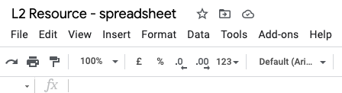
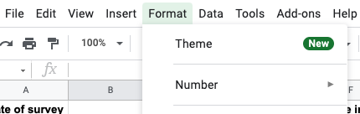
Applying number formats
Activity 3
1
Click on ‘format’
3
Choose a format from the list
2
Hover over ‘Number’

Slide 11
Duration format
Activity 3
If you write text and numbers in the same cell, it can’t be used for calculations.
And you couldn’t write ‘33’ in the cell as this might indicate 33 hours.
In fact the computer will display 792, which is 33 days in hours!
To solve this problem, spreadsheets format the duration into hour hour : minute minute : second second.
So 3 hours and 3 minutes looks like this:
hh:mm:ss
03:03:00
3 hours 3 minutes
Notes:
‘Duration’ is used to record periods of time such as the length of a journey. Tell the learners that they will use this to format the ‘Travel duration’ column in their spreadsheet.

Slide 12

Why apply formatting?
Plenary
Think, pair, share: Why is it a good idea to apply formatting to cells in spreadsheets?
It makes them easier to use
It makes them easier to read
It shows you what each cell contains
Notes:
Sticky note: https://pixabay.com/vectors/note-post-it-reminder-sticky-note-147951/

Slide 13

How confident are you? (1–3)
Assessment
I can explain what an item of data is
I can choose an appropriate format for a cell
I can apply an appropriate format to a cell
3 - Very confident
2 - Unsure
1 - Not confident
Notes:
Image source: https://pixabay.com/vectors/thumb-up-hand-like-confirm-go-top-307176/

Slide 14
Next lesson
Summary
In this lesson, you…
Learned what a data item is and what they can look like
Identified the formats of different data items
Applied formatting to your own data items
Next lesson, you will…
Explain that formulas can be used to produce calculated data

