Slide 1
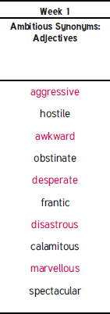
EMW
Please practise these spellings and copy them out in your best handwriting!
See you all at 930am ☺
Accident-prone
Accommodate
Accompany
Accountancy
Align
Amateur
Apparent
Appreciate
Assign
audible

Slide 2

Tuneful Tuesday!
https://www.youtube.com/watch?v=-uJSAlo0sQs
Word of the week:

Slide 3
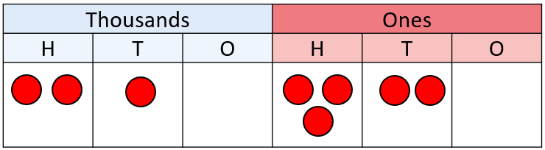

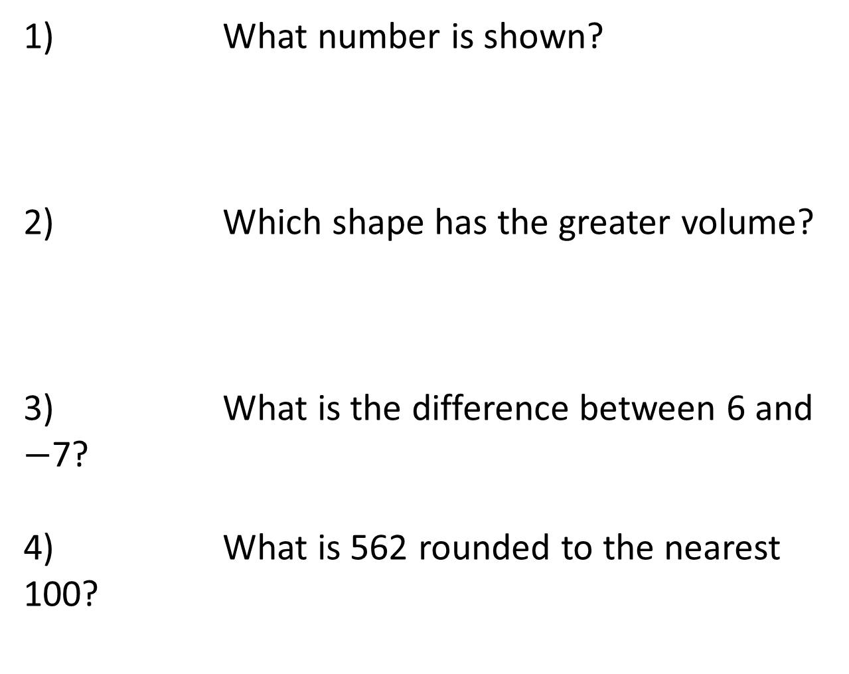
Year 6 | Week 1 | Day 2
CCC
1) What number is shown?
2) Which shape has the greater volume?
3) What is the difference between 6 and $−$7?
4) What is 562 rounded to the nearest 100?
A
B

Slide 4
Year 6 | Week 1 | Day 2
CCC
1) What number is shown?
2) Which shape has the greater volume?
3) What is the difference between 6 and $−$7?
4) What is 562 rounded to the nearest 100?
210,320
A
B
A
13
600

Slide 5
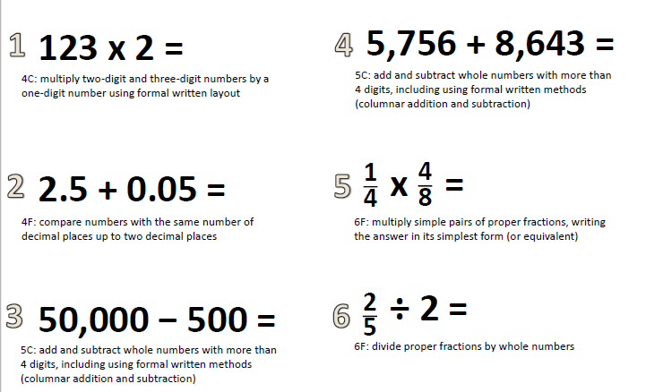

Slide 6


Complete the calculations.
Write the answers in Roman numerals.
100 + CCLXXX =
DCCVIII – 405 =
CCXXIV + 210 =
Y5
© Classroom Secrets Limited 2018

Slide 7
Complete the calculations.
Write the answers in Roman numerals.
100 + CCLXXX = | CCCLXXX
DCCVIII – 405 = | CCCIII
CCXXIV + 210 = | CDXXXIV
Y5
© Classroom Secrets Limited 2018

Slide 8
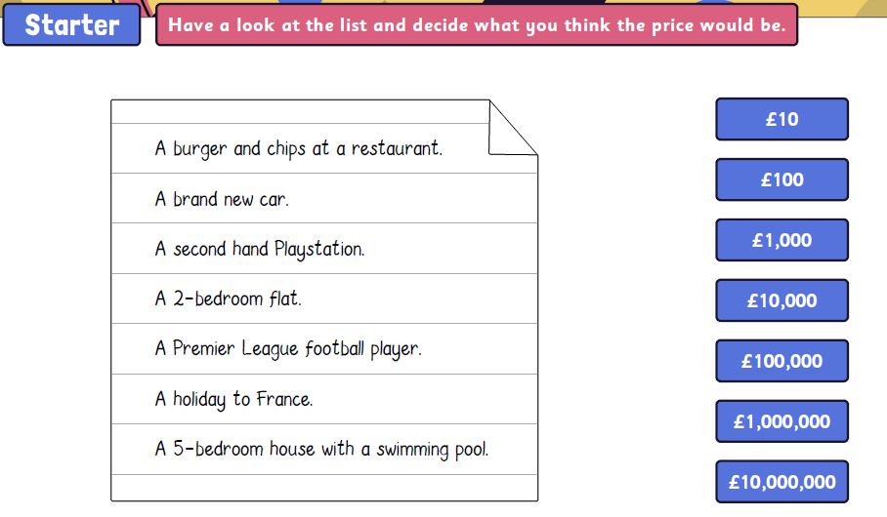

Slide 9
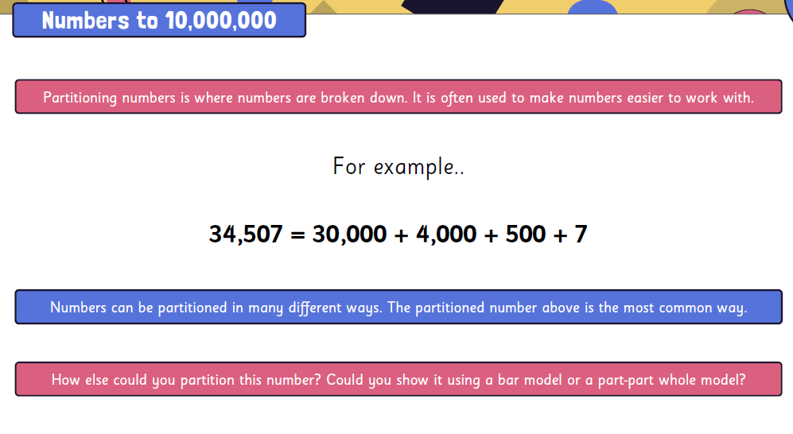

Slide 10
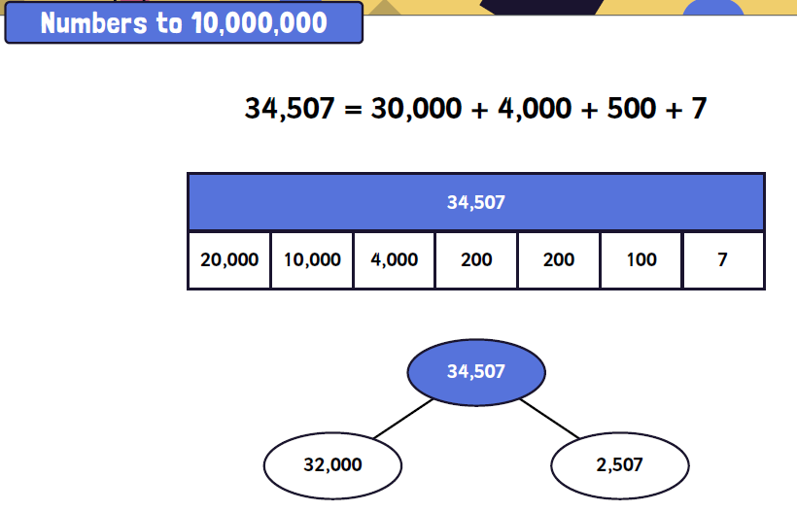

Slide 11
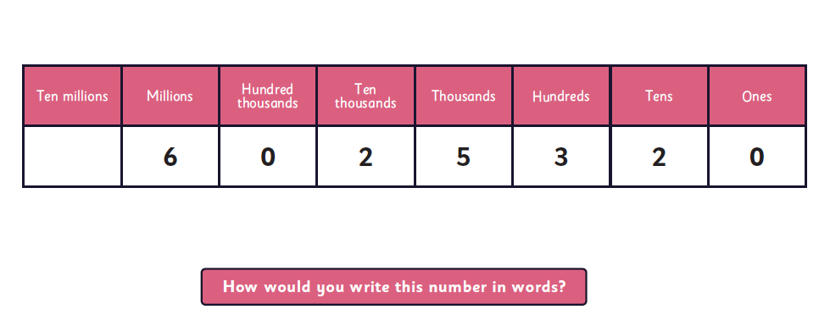

Slide 12
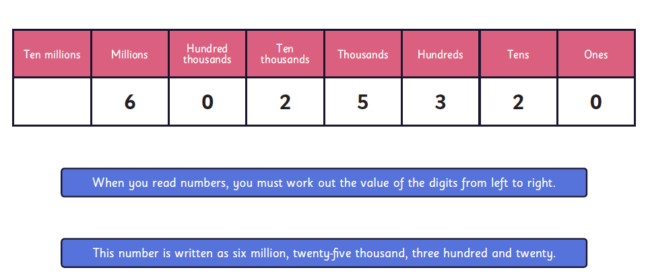

Slide 13
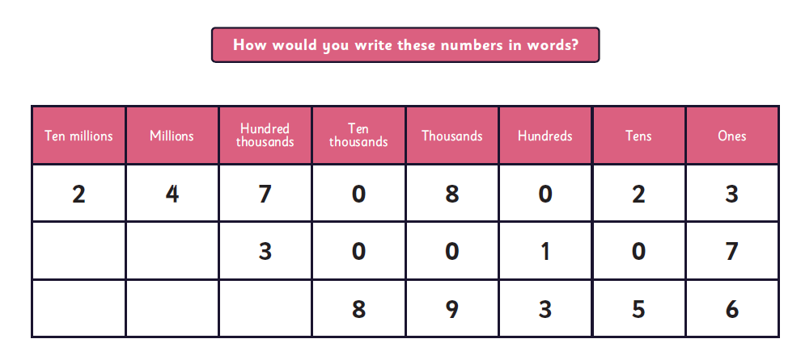

Slide 14
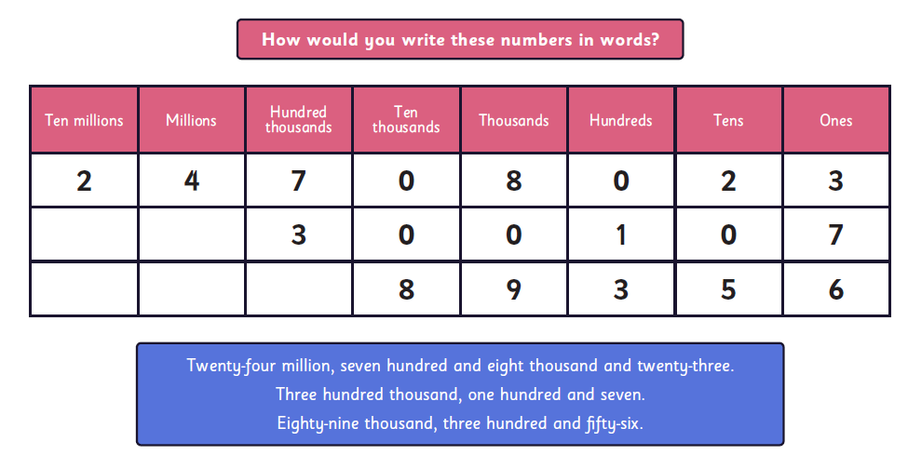

Slide 15
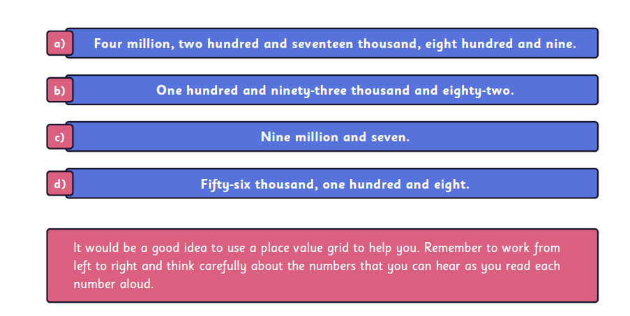

Slide 16
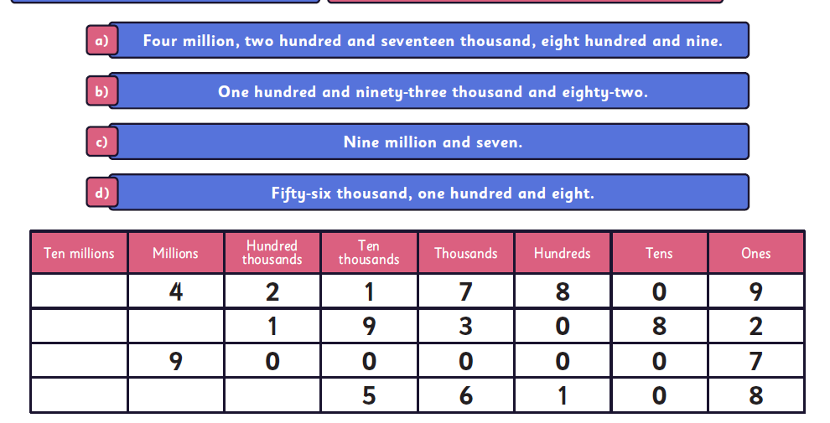

Slide 17
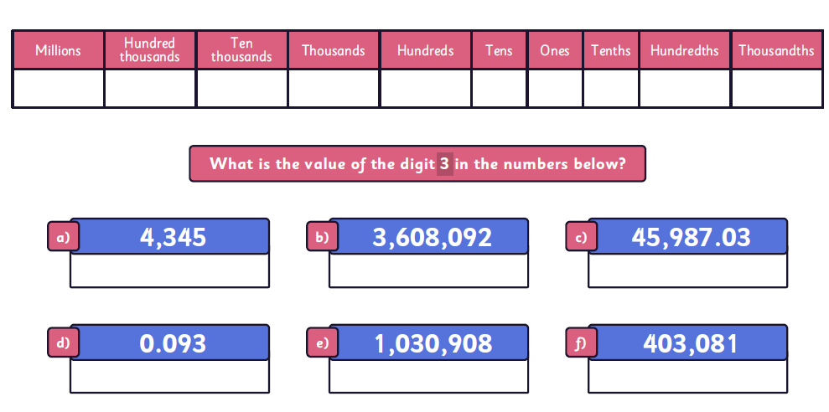

Slide 18
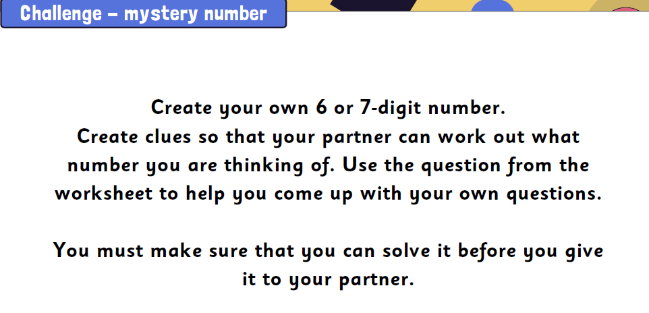

Slide 19
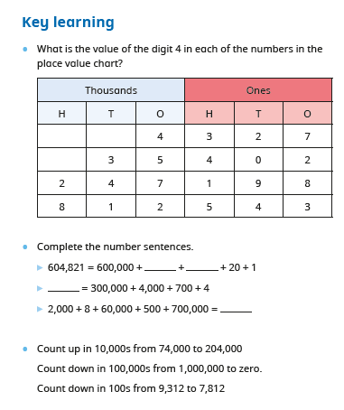

Slide 20

Let’s talk
What is the next column heading? How is that written?
What is the largest 6-digit number?
What is the smallest 6-digit number?
? | Ten Thousands | Thousands | Hundreds | Tens | Ones
? | 10,000 | 1,000 | 100 | 10 | 1
©Deepening Understanding LTD 2019

Slide 21
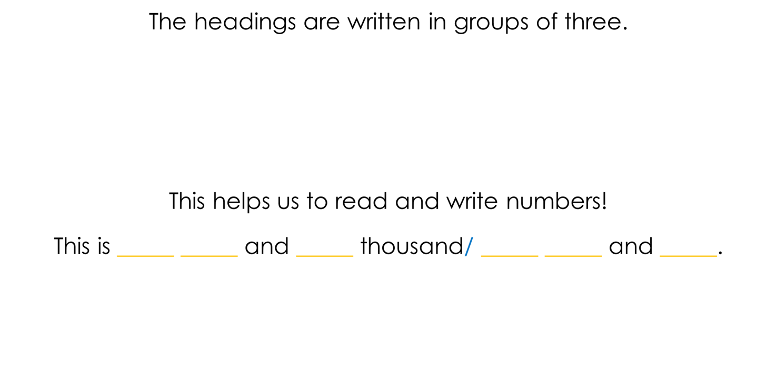
Let’s learn
Hundred Thousands | Ten Thousands | Thousands | Hundreds | Tens | Ones
1 | 2 | 7 | 4 | 2 | 2
©Deepening Understanding LTD 2019

Slide 22
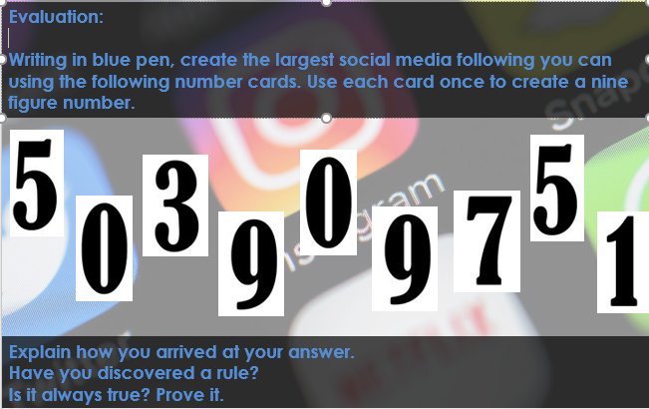

Slide 23
Let’s learn
Let’s use a stem sentence to read and write this number.
This number has ____ millions, ____ hundred thousands, ____ ten thousands, ____ thousands, ____ hundreds and ____ ones.
This number is ________ million, ________________________________ thousand, ________________________________.
3,562,207
©Deepening Understanding LTD 2019

Slide 24
Let’s learn
Let’s use a stem sentence to read and write another number.
This number has ____ millions, ____ ten thousands, ____ thousands, ____ hundreds, ____ tens and ____ ones.
This number is ________ million, ________________________________ thousand, ________________________________.
9,069,881
©Deepening Understanding LTD 2019

Slide 25
Let’s learn
Numbers can be partitioned in different ways.
This number has 2 millions and 7 hundred thousands which is the same as saying 27 hundred thousands!
How many 10 thousands does this number have?
278 ten thousands!
2,784,974
©Deepening Understanding LTD 2019

Slide 26
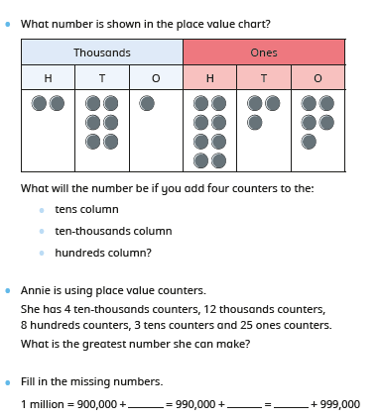

Slide 27
Let’s talk
Find 2 different ways to partition this number.
Write a number sentence like this to represent it…
2,784,974 = 2,000,000 + 500,000 + 280,000 + 4,974.
2,784,974
©Deepening Understanding LTD 2019

Slide 28

Partitioning
Now partition:
1,356,723
19,896,534

Slide 29
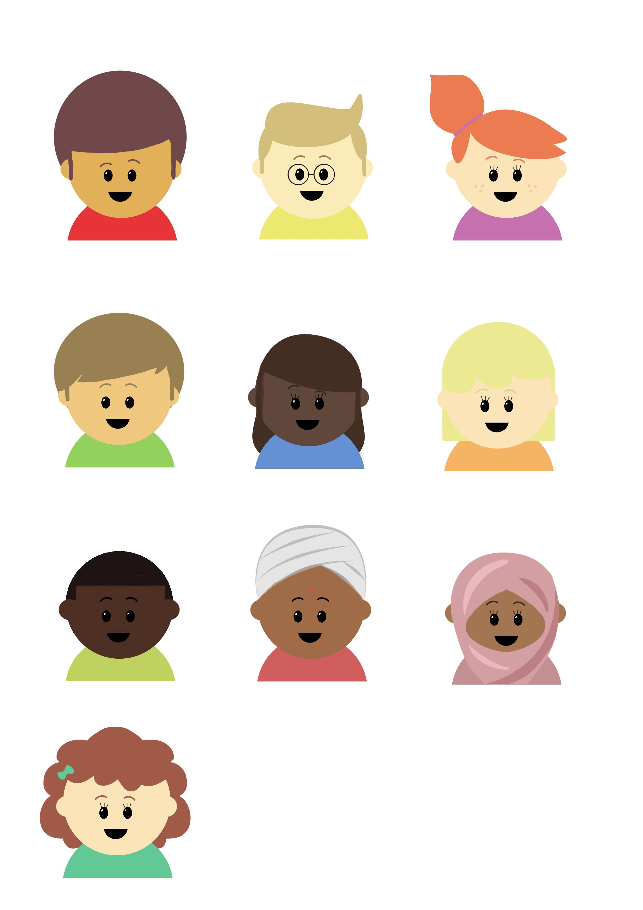
Let’s prove we can do this task!
Use these digit cards to help Millie create 8 different 6-digit numbers that are a multiple of 3. How do you know it is a multiple of 3?
Put your numbers in descending order.
0
1
2
3
4
5
6
7
8
9
©Deepening Understanding LTD 2019

Slide 30
Let’s develop our learning
Millie’s number has some digits missing…
If Millie has at least 760 thousands, what could her number be?
7,_ _9, 874
©Deepening Understanding LTD 2019

Slide 31
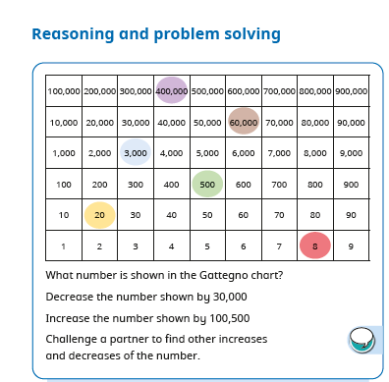
Stick in

Slide 32
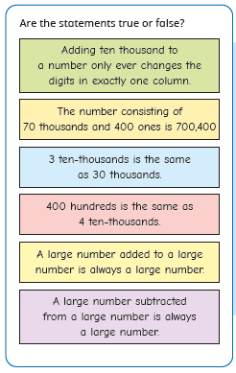
Stick in

Slide 33
Independent Task
Let’s showcase our learning
Please see the sheet for the questions
We are writing the full answers in our books – like this!
©Deepening Understanding LTD 2019

Slide 34
Exit task
Millie used 29 counters to represent a number on this chart.
There are at least 3 counters in each column.
From millions, each alternate column has the same even number of counters.
The other columns contain an odd number of counters.
What could Millie’s number be?
M | HTh | TTh | Th | H | T | O
©Deepening Understanding LTD 2019

