Slide 1

Welcome back! This word of the week is:
What does it mean? Use it in a sentence and post on GC – most inventive gets 10 dabs!

Slide 2
EMW
Today I would like you to play 5 3 minute TTRockstars games as EMW
Maths for today is attached.
The powerpoint is a reminder about Roman Numerals. This will consolidate your learning from Year 4 and 5.
Please complete the questions from the chilli you feel is best suited to you or answer the questions in the powerpoint. No printing is required.
Remember I am expecting you to work for around an hour on Maths. Please message me if you need any help ☺

Slide 3

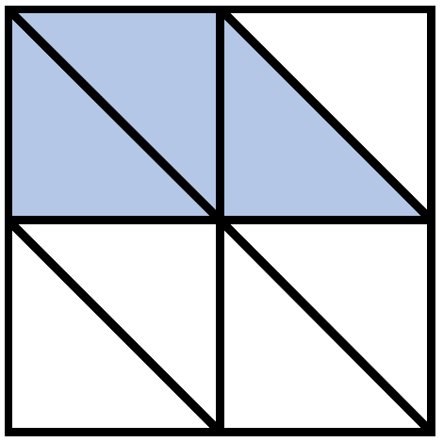
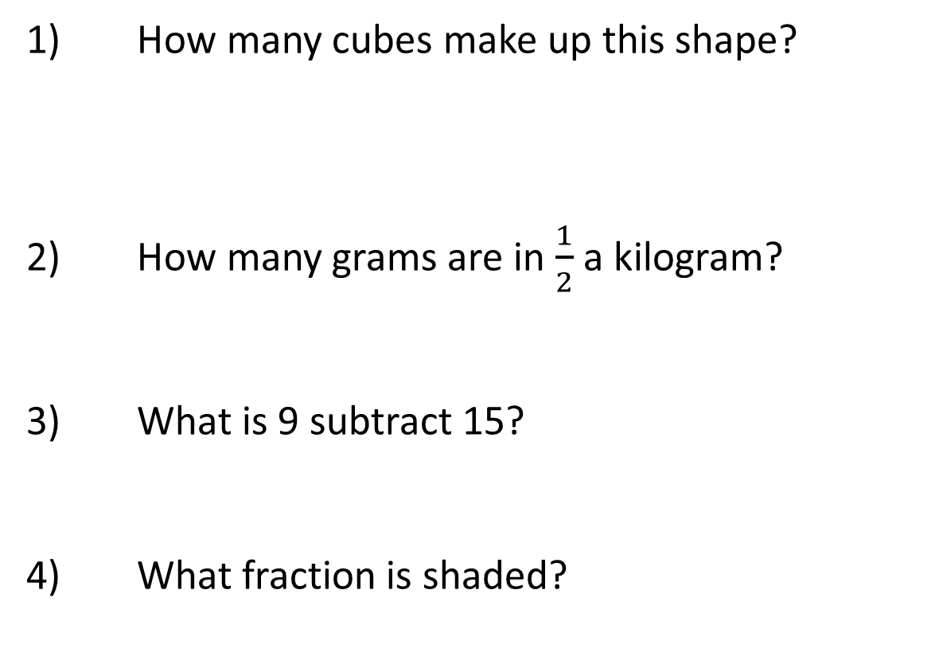
Year 6 | Week 1 | Day 1
XII
1) How many cubes make up this shape?
2) How many grams are in $\frac{1}{2}$ a kilogram?
3) What is 9 subtract 15?
4) What fraction is shaded?
cubes

Slide 4
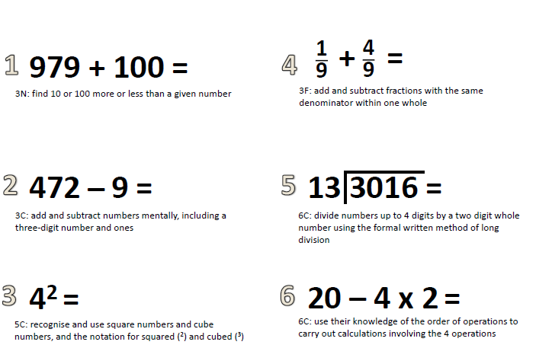

Slide 5
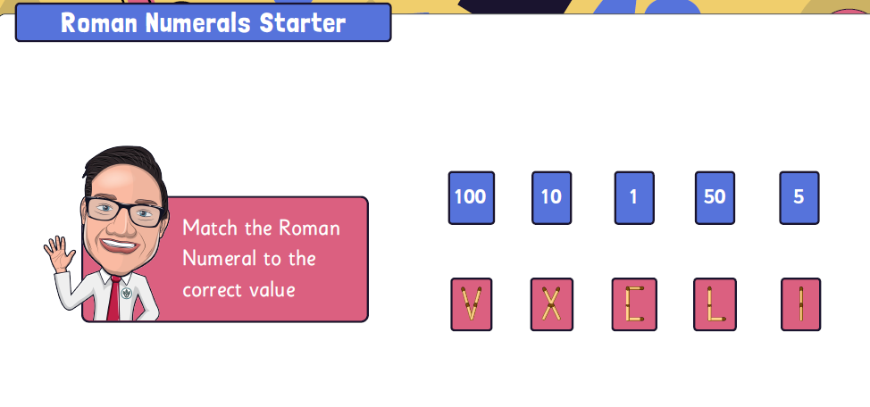

Slide 6
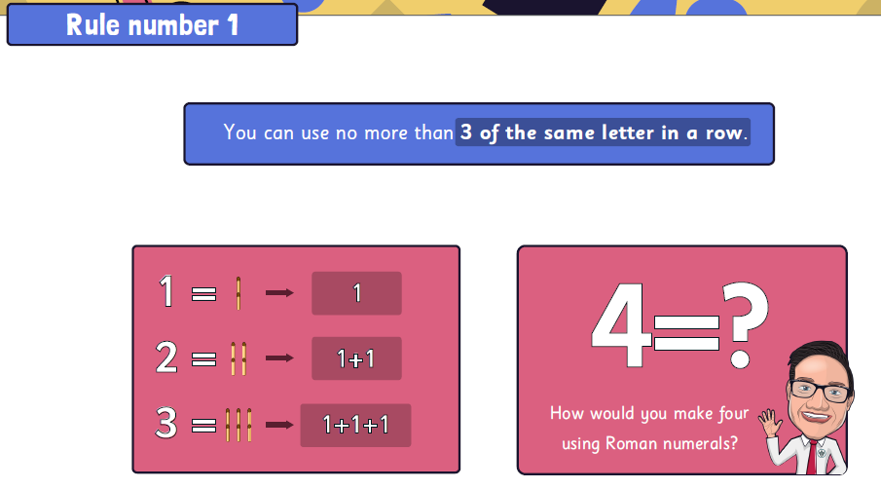
RULES

Slide 7
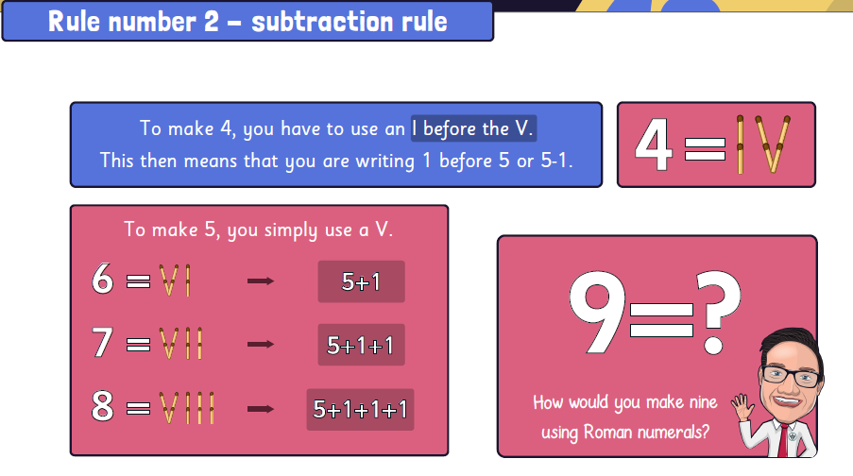

Slide 8
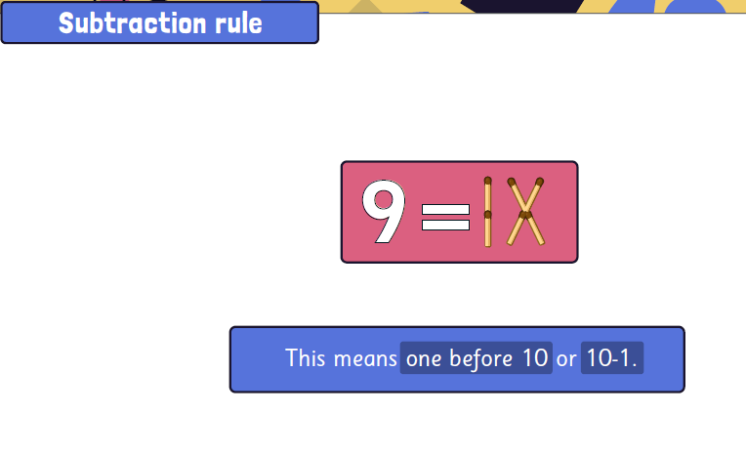

Slide 9
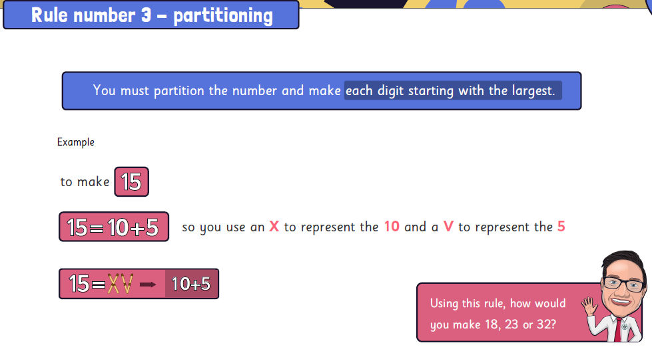

Slide 10
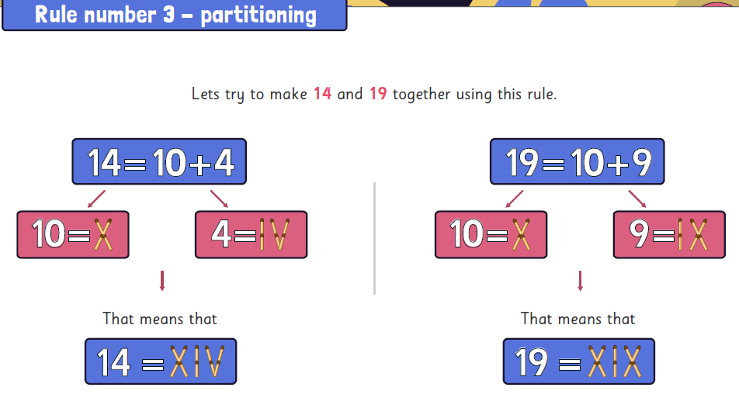

Slide 11
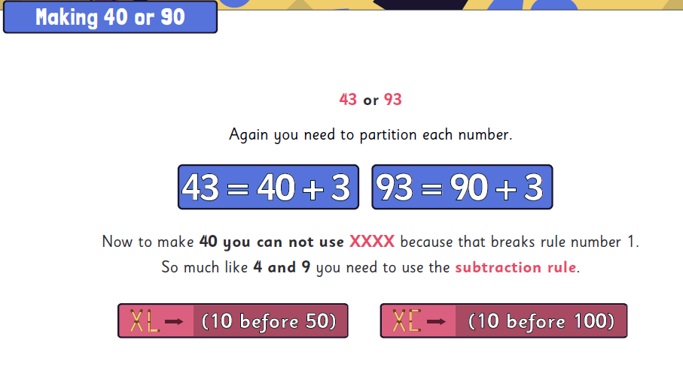

Slide 12
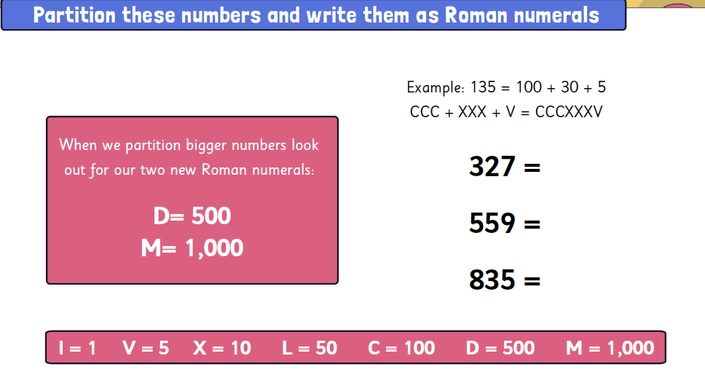

Slide 13
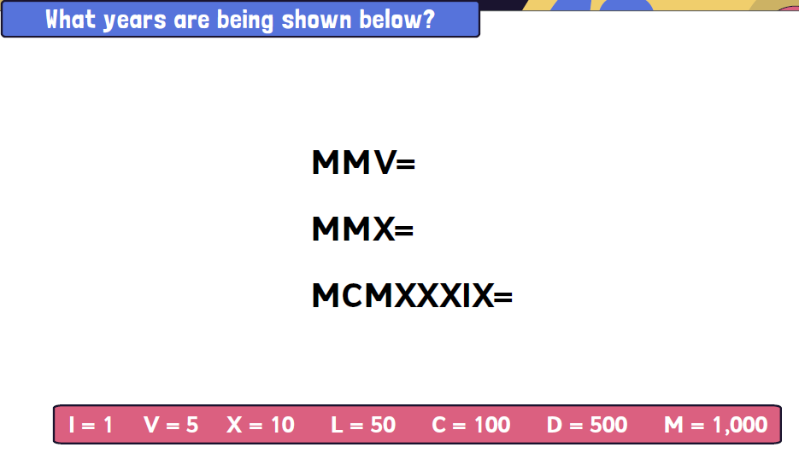

Slide 14

Let’s do this!
Spot the Mistakes!
How should the numbers be written in Roman numerals?
15 | 26 | 77 | 100
XIIIII | XXIV | LXXLXX | H

Slide 15

Let’s revisit what we should know..
The multiples of 10 in Roman numerals are written like this.
Can you spot any patterns?
10 | X | 60 | LX
20 | XX | 70 | LXX
30 | XXX | 80 | LXXX
40 | XL | 90 | XC
50 | L | 100 | C

Slide 16

Let’s talk
There are only 2 more Roman numerals to learn and then any number can be written!
D = 500 and M = 1,000
How do you think 400 is written?
What about 900?

Slide 17
Let’s learn
400 is written CD
Which is 100 less than 500.
900 is written CM
Which is 100 less than 1,000.
Write these numbers in Roman numerals.
425
956
425
942

Slide 18
Let’s develop our learning
We can calculate with Roman numerals!
Add 10 to each of these numbers.
Now, subtract 100 from your new number
CXCIX
DXXXVII
CCIX
DXLVII
CIX
CDXLVII

Slide 19
Exit task – Dong Nao Jin
Use these Roman numerals once and any operation to get as close as possible to the target number.
DCLXXXV
XI
C
II
V
VIII

Slide 20
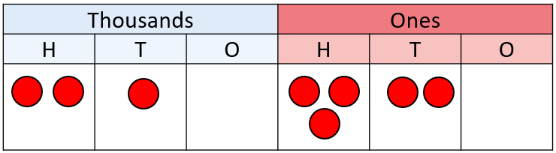

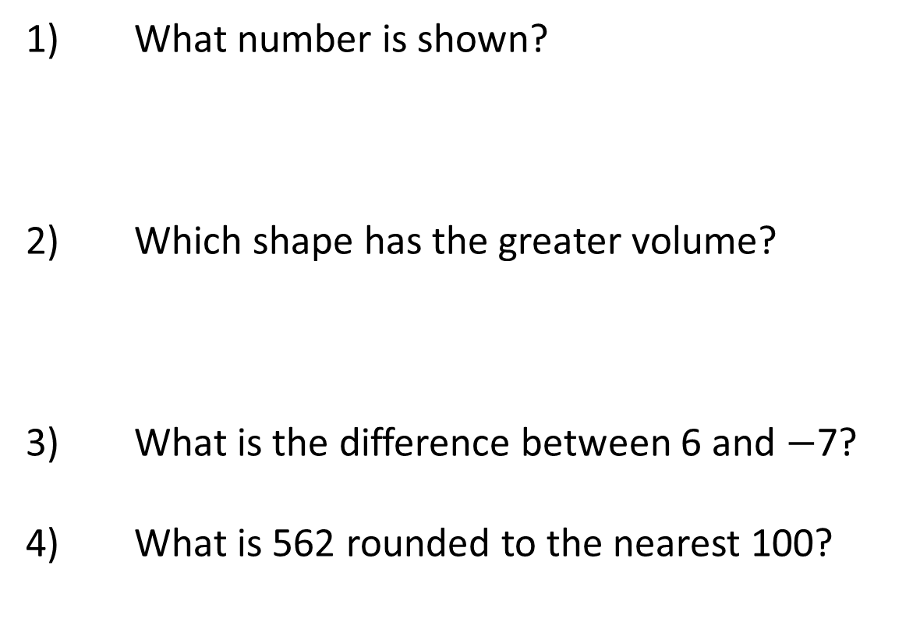
Year 6 | Week 1 | Day 2
CCC
1) What number is shown?
2) Which shape has the greater volume?
3) What is the difference between 6 and $−$7?
4) What is 562 rounded to the nearest 100?
A
B

Slide 21
Now we are going to practice our times tables
See what you can remember. You are only working on improving yourself so do not even think about other people’s scores.

Slide 22
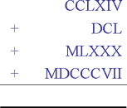
The Romans could only count
For the Romans large numbers were a pain, as you can see, but their number system was also useless when it comes to doing any calculations.
They had two problems - firstly they did not have zero and secondly they did not have a system which allowed for "place value" in other words the position of a number told you nothing about its value (so in Roman numerals a C means 100 wherever you see it). Whereas, in our number system you know the value of a number by its column counted from the right (ones, tens, hundreds, etc.)
The Romans, and Greeks, did not have a zero and their ability to calculate suffered as a result.

Slide 23


RECAP
Complete the missing parts of the Roman numeral 100 square.
I = 1 |  | V = 5 |  | X = 10 |  | L = 50 |  | C = 100
V | VI
XV
 | LII | LIII
LXI | LXII
 |  | LXXIII
 | LXXIX | LXXX
LXXXVIII
XCVIII
 | II
XI
Y5
© Classroom Secrets Limited 2018

Slide 24
Complete the missing parts of the Roman numeral 100 square.
I = 1 |  | V = 5 |  | X = 10 |  | L = 50 |  | C = 100
V | VI | VII
XV
XXV
XXXV
 | LII | LIII
LXI | LXII | LXIII
LXXI | LXXII | LXXIII
LXXVIII | LXXIX | LXXX
LXXXVIII | LXXXIX
XCVIII | XCIX
 | II
XI | XII | XIII
 | XXII
Y5
© Classroom Secrets Limited 2018

Slide 25
Complete the sequences by filling in the
missing Roman numerals.
a) | CXLVI |  | CXLVIII
b) |  | CCX |  | CCXII
c) | CCXCI |  | CCXCIII
Y5
© Classroom Secrets Limited 2018

Slide 26
Complete the sequences by filling in the
missing Roman numerals.
a) | CXLVI | CXLVII | CXLVIII | CXLIX
b) | CCIX | CCX | CCXI | CCXII
c) | CCXCI | CCXCII | CCXCIII | CCXCIV
Y5
© Classroom Secrets Limited 2018

Slide 27
Write the following Roman numerals in ascending order.
CDXXXIII | CCXX | DLVI | CXXVI
Y5
© Classroom Secrets Limited 2018

Slide 28
Write the following Roman numerals in ascending order.
CDXXXIII | CCXX | DLVI | CXXVI
CXXVI | CCXX | CDXXXIII | DLVI
126 | 220 | 433 | 556
Y5
© Classroom Secrets Limited 2018

Slide 29
Use <, > or = to complete the statements.
DCCCIX |  | 809
DCLXXII |  | 627
712 |  | DCCXXII
Y5
© Classroom Secrets Limited 2018

Slide 30
Use <, > or = to complete the statements.
DCCCIX | = | 809
DCLXXII | > | 627
712 | < | DCCXXII
Y5
© Classroom Secrets Limited 2018

Slide 31
World War 1 began in 1914.
Circle the correct Roman numeral.
MCMXV | MCMXVI | MCMXIV
Y5
© Classroom Secrets Limited 2018

Slide 32
World War 1 began in 1914.
Circle the correct Roman numeral.
MCMXV | MCMXVI | MCMXIV
Y5
© Classroom Secrets Limited 2018

Slide 33
Complete the calculations.
Write the answers in Roman numerals.
100 + CCLXXX =
DCCVIII – 405 =
CCXXIV + 210 =
Y5
© Classroom Secrets Limited 2018

Slide 34
Complete the calculations.
Write the answers in Roman numerals.
100 + CCLXXX = | CCCLXXX
DCCVIII – 405 = | CCCIII
CCXXIV + 210 = | CDXXXIV
Y5
© Classroom Secrets Limited 2018

Slide 35
Using your knowledge of Roman numerals to 1,000,
work out the value of the Roman numeral below.
MM
Explain your reasoning.
Y5
© Classroom Secrets Limited 2018

Slide 36
Using your knowledge of Roman numerals to 1,000,
work out the value of the Roman numeral below.
MM
Explain your reasoning.
MM = 2,000 because...
Y5
© Classroom Secrets Limited 2018

Slide 37
Using your knowledge of Roman numerals to 1,000,
work out the value of the Roman numeral below.
MM
Explain your reasoning.
MM = 2,000 because M = 1,000 so two Ms must equal 2,000.
Y5
© Classroom Secrets Limited 2018

Slide 38
Arrange the cards below to create different Roman numerals. Each card may only be used once.
Find all the possibilities.
I
X
C
I
Y5
© Classroom Secrets Limited 2018

Slide 39
Arrange the cards below to create different Roman numerals. Each card may only be used once.
Find all the possibilities.
There are 2 possibilities:
CXII (112)
XCII (92)
I
X
C
I
Y5
© Classroom Secrets Limited 2018

Slide 40
Rules
In pairs discuss the rules for Roman Numerals and jot them in your maths books

Slide 41
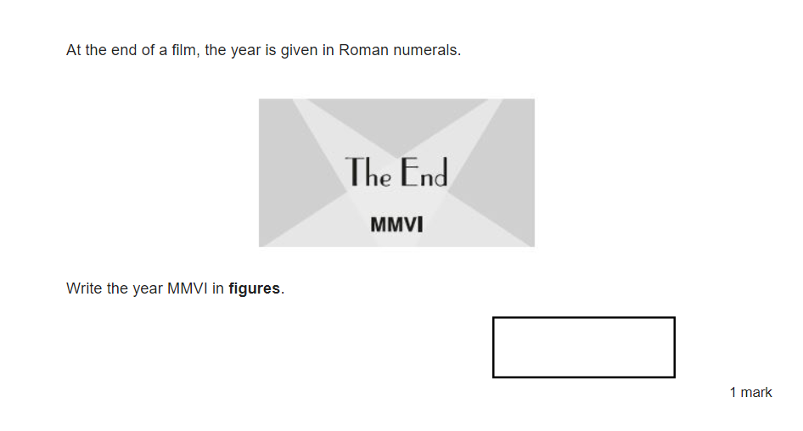
Complete these tasks in your books

Slide 42
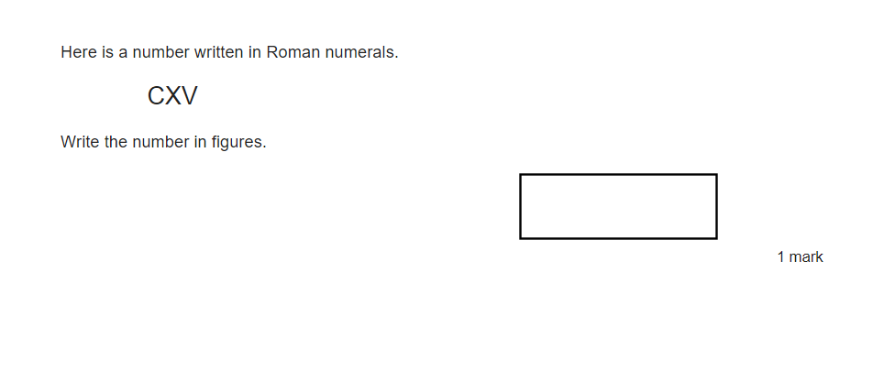

Slide 43
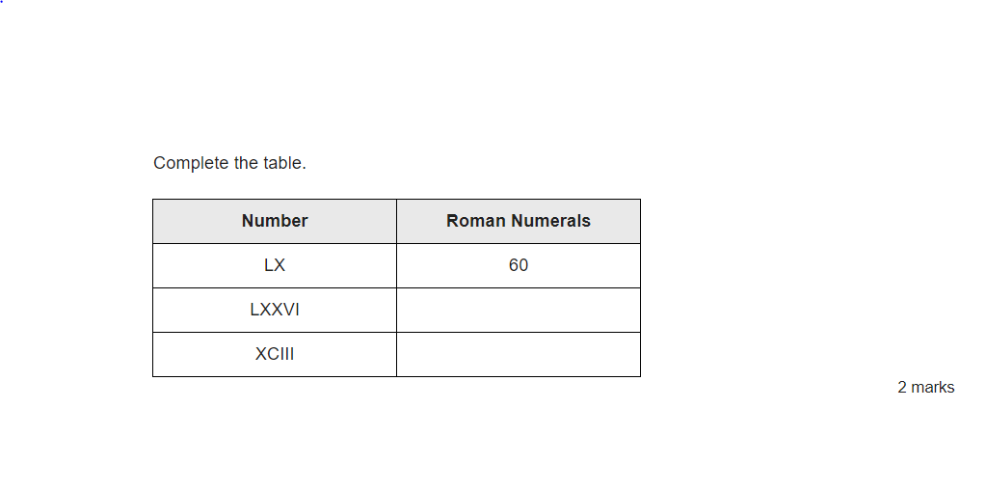

Slide 44
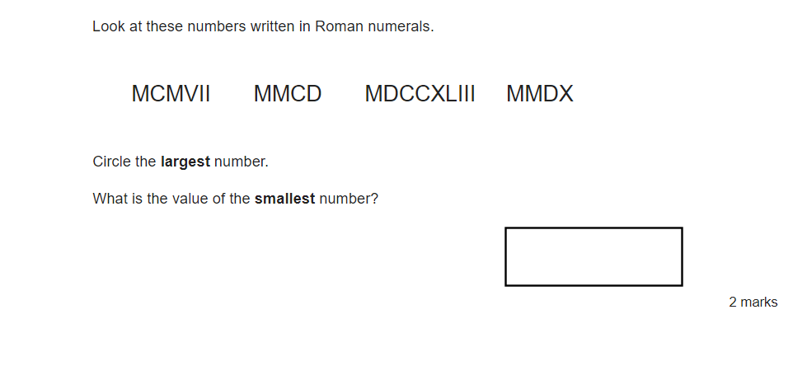

Slide 45
