Slide 1
Shape
2-D shapes (circles and quadrilaterals)
Objectives
Day 1
Name parts of circles.
Day 2
Classify and sort quadrilaterals.
Notes:
Before teaching, be aware that:
On Day 1 children will need compasses, rulers and string.
On Day 2 children will need rulers. You will need access to the internet.

Slide 2
Shape
2-D shapes (circles and quadrilaterals)
Starters
Day 1
Describe 2-D shapes (pre-requisite skills)
Suggested for Day 2
Find lines of symmetry (simmering skills)
Notes:
Choose starters that suit your class by dragging and dropping the relevant slide or slides below to the start of the teaching for each day.

Slide 3

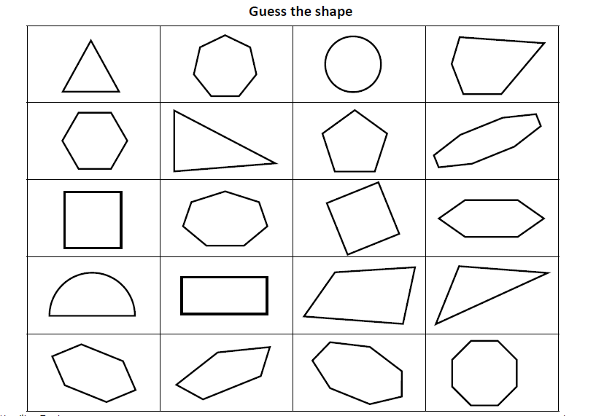
Shape
2-D shapes (circles and quadrilaterals)
Starter
Describe 2-D shapes
Notes:
Pre-requisite skills – to use this starter, drag this slide to the start of Day 1
Display Shape Game board (see resources). Choose a shape. In pairs, children write at least 5 facts about it. Take feedback to include: regular/non-regular; number of vertices/sides; number of right/obtuse/acute angles; lines of symmetry. Remind children that a polygon only has straight sides, so a circle, oval, semi-circle are not polygons but are 2-D shapes. Secretly choose a shape, children work out which it is by asking questions about its properties to which you can only answer ‘yes’ or ‘no’.

Slide 4
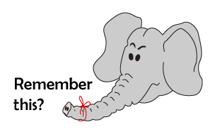
Shape
2-D shapes (circles and quadrilaterals)
Starter
Find lines of symmetry
Notes:
Simmering skills – to use this starter, drag this slide to the start of Day 2
Challenge pairs of children to draw as many polygons as they can in 3 minutes with only 1 line of symmetry. They swap with another pair to compare. Share the most unusual shapes with the class.
Repeat: this time the shapes must be quadrilaterals. Repeat: now they must be quadrilaterals with 2 lines of symmetry.

Slide 5
Shape
2-D shapes (circles and quadrilaterals)
Objectives
Day 1
Name parts of circles.

Slide 6

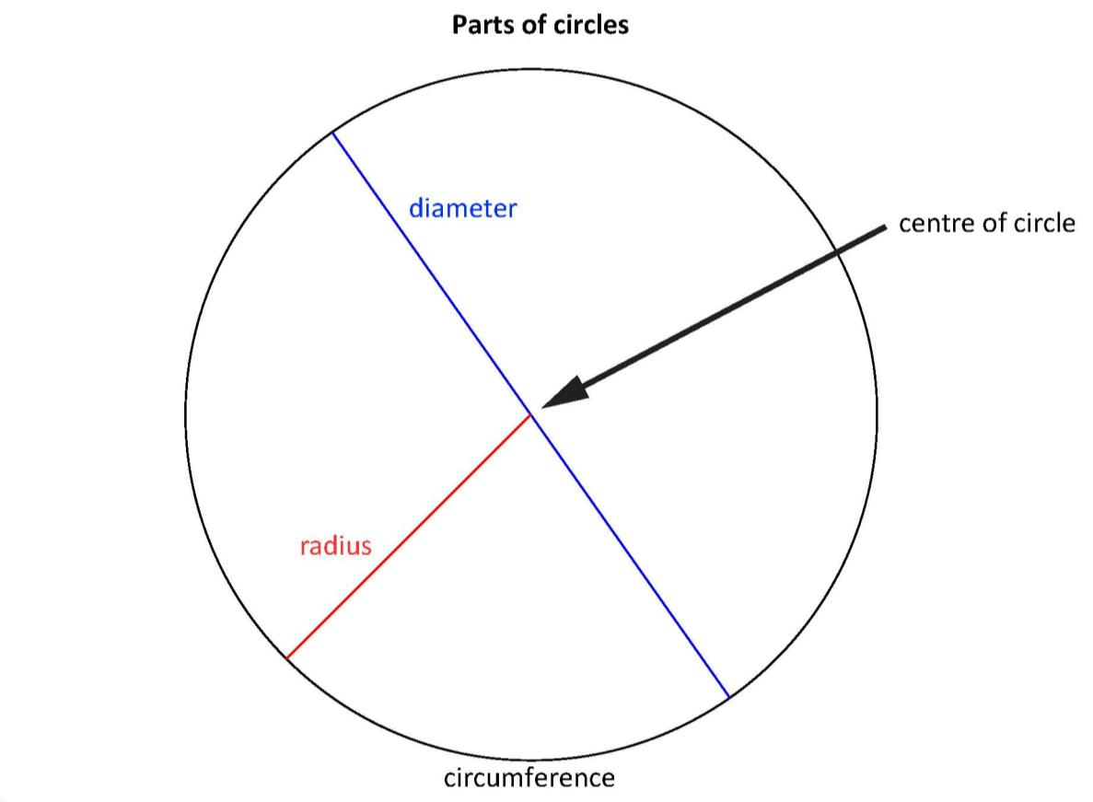

Day 1: Name parts of circles.
How would you explain what a radius, diameter and circumference are to someone who can’t see this diagram?
What is the relationship between the diameter and radius as a ratio?
It is less obvious whether there is a relationship between the circumference and the diameter or radius – but today you will find out!
Notes:
Take feedback and agree definitions for radius, diameter and circumference.
Agree the relationship between the diameter and radius as 2 to 1, 2:1, i.e. the diameter is twice the radius.

Slide 7
Day 1: Name parts of circles.
If you draw a circle with a radius of 5cm, what will the diameter be?
Use a pair of compasses to draw a circle with a radius of 5cm. Align the point with 0 on a ruler and the pencil tip with 5cm. Check that the diameter is 10cm.
How could you measure the circumference?
Use string to curl round the circumference, mark where it meets the end, then measure this distance along the string with a ruler.
Notes:
Today would be a great day to use a problem-solving investigation – Ellipse in a Circles – as the group activity, which you can find in this unit’s IN-DEPTH INVESTIGATION box on Hamilton’s website.
Alternatively, children can now go on to do differentiated GROUP ACTIVITIES. You can find Hamilton’s group activities in this unit’s TEACHING AND GROUP ACTIVITIES download.
Children draw circles, measure diameters and circumferences with string and work out ratio. Pi is introduced.
There are adaptations for WT/ARE/GD.

Slide 8
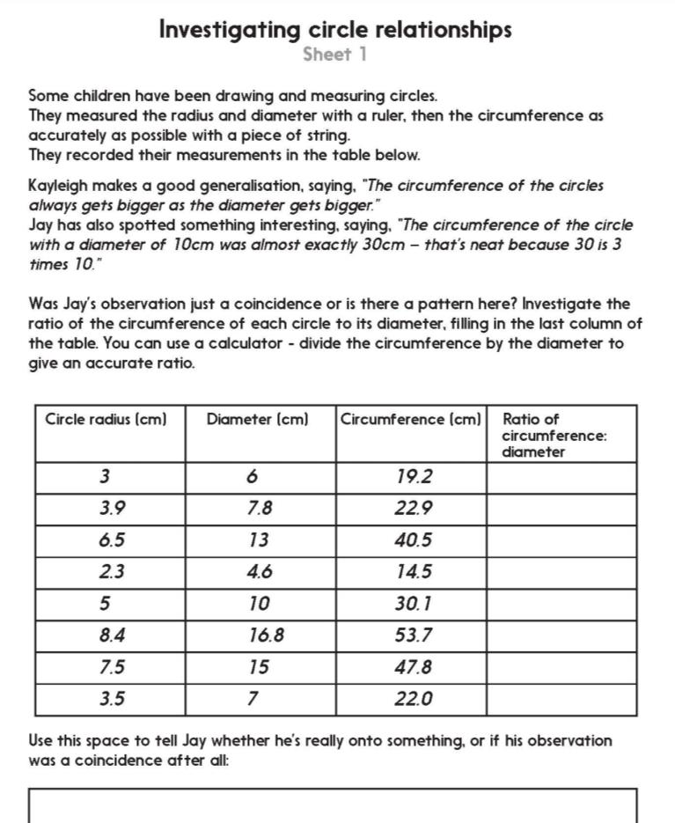
Notes:
The Practice Sheet on this slide is suitable for most children.
Differentiated PRACTICE WORKSHEETS are available on Hamilton’s website in this unit’s PROCEDURAL FLUENCY box.
WT/ARE/GD: Investigating circle relationships. Children interpret a table of data to try to discover any relationship between a circle’s circumference and its diameter.
GD: Children also complete the challenge on Sheet 2.

Slide 9
Shape
2-D shapes (circles and quadrilaterals)
Objectives
Day 2
Classify and sort quadrilaterals.

Slide 10

Day 2: Classify and sort quadrilaterals.
Draw a quadrilateral (4 straight sides), different from your neighbour’s.
Describe your shape to your partner and agree what is different and what is the same.
Whose shape has at least one pair of perpendicular sides? What shape is it?
Whose shape has at least one pair of parallel sides? What shape is it?
Whose shape has four right angles? What shape is it?
Whose shape has four equal sides? What shape is it?
Rectangles have all right angles.
A rhombus has equal sides, but 2 different angle sizes (opposite angles equal).
Squares have all right angles AND four equal sides.
Notes:
You may want to discuss how a square is a ‘special’ rectangle, and also a ‘special’ rhombus!

Slide 11
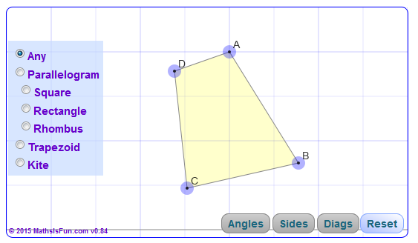
Day 2: Classify and sort quadrilaterals.
Let’s explore quadrilaterals!
Click on the picture to go to the site.
Click on ‘angles’ and each shape in turn. Move a point and see what happens to the shape.
Repeat, this time clicking on ‘diagonals’.
Notes:
Click on angles and each shape in turn. Move a point and see what happens to the shape, e.g. how the lengths of sides are always the same in a rhombus, a kite has one pair of opposite angles the same and 2 pairs of sides the same length, a trapezium has at least 1 pair of parallel sides, a parallelogram has 2 pairs of parallel sides, etc. Point out how a square is actually a special rectangle, parallelogram, kite or rhombus!
Repeat, this time clicking on ‘diagonals’. Discuss which shapes have diagonals perpendicular to 1 another, reminding children that perpendicular means at right angles to each other.

Slide 12

Day 2: Classify and sort quadrilaterals.
What criteria could we use to sort these quadrilaterals in this Venn diagram?
Notes:
Take suggestions, e.g. at least 1 pair of parallel sides, at least 1 line of symmetry.
Children can now go on to do differentiated GROUP ACTIVITIES. You can find Hamilton’s group activities in this unit’s TEACHING AND GROUP ACTIVITIES download.
Children make a range of quadrilaterals using art straws. Copy into books and identify features. Sort with sorting tree or Venn diagram.
There are adaptations for WT/ARE/GD.

Slide 13
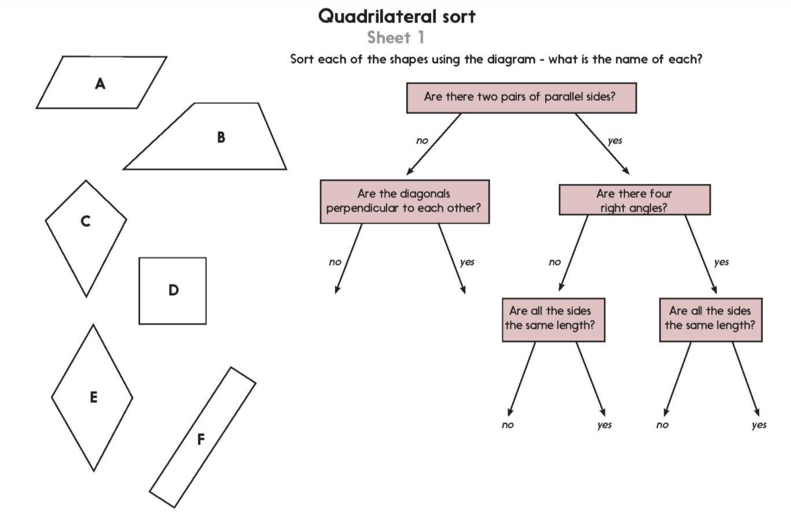
Notes:
The Practice Sheet on this slide is suitable for most children.
Differentiated PRACTICE WORKSHEETS are available on Hamilton’s website in this unit’s PROCEDURAL FLUENCY box.
WT/ARE: Sort quadrilaterals.
GD: Quadrilaterals challenge.

Slide 14

Shape
2-D shapes (circles and quadrilaterals)
Well Done! You’ve completed this unit.
Objectives
Day 1
Name parts of circles.
Day 2
Classify and sort quadrilaterals.
Notes:
You can now use the Mastery: Reasoning and Problem-Solving questions to assess children’s success across this unit. Go to the next slide.

Slide 15
Shape
Problem solving and reasoning questions
Draw a circle and label the radius and diameter.
Explain how you could find the diameter.
Use damp string to measure the circumference of a small plate. Now measure its diameter and calculate the circumference.
How close was your damp string measurement?
Mystery quadrilaterals
I have one pair of non-equal parallel sides. What am I?
I have two pairs of equal sides, but no sides are parallel. Two opposite angles are equal but not the other two. What am I?

Slide 16
Problem solving and reasoning answers
Draw a circle and label the radius and diameter. Explain how you could find the diameter.
The radius should be clearly marked as a line from a point on the circumference to the centre of the circle; the diameter as a straight line through the centre of the circle beginning and ending at points on the circumference. You can find the diameter by doubling the length of the radius.
Use damp string to measure the circumference of a small plate. Now measure its diameter and calculate the circumference. How close was your damp string measurement?
The circumference is equal to the diameter multiplied by pi (3.14) i.e. just over 3 times the diameter, children’s measurements should reflect that.
Mystery quadrilaterals
I have one pair of non-equal parallel sides. What am I? A trapezium
e.g. or
I have two pairs of equal sides, but no sides are parallel. Two opposite angles are equal but not the other two. What am I? A kite
Children will find it helpful to sketch the shapes in questions like these.

