Slide 1
My challenge for others to complete on Friday
Secret squirrel project
By Melanie

Slide 2
My challenge for you is to create an:
Obstacle race for you and your family to complete!!!!

Slide 3

What you will need:
A camera or something to film it on
Objects which you could use
A large area to complete your obstacle course

Slide 4
How to complete this activity

Slide 5
Find a large space to complete your course
Gather your objects and family to come and join in
Set up your obstacle course and ask a member of your family to film you completing it
Make sure you have fun and I hope you like this challenge

Slide 6
This is my obstacle course to give you some 💡 ideas

Slide 7
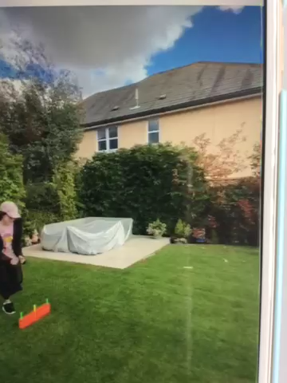

Slide 8
The end
By Melanie

