Slide 1

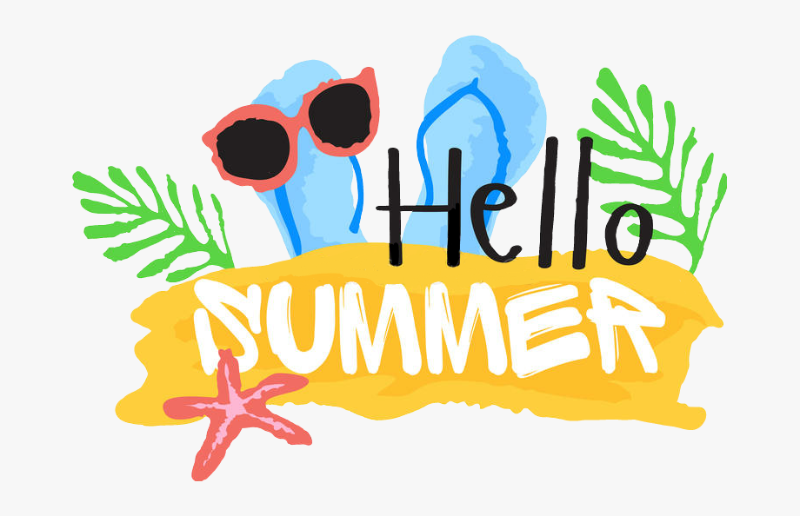
EYFS/KS1 Creative Project
Food
Design and create your own fruit smoothie
Beside The
Seaside
History
Research how summer holidays have changed over time
Creativity
Design your own holiday island
Draw or paint a picture of your favourite holiday you have been on
Design your own water park and write a set of safety rules
Design your own beach towel
Design your own ice cream/ ice lolly- challenge: to create a 3D version
Suitcase Challenge!
Pack a suitcase for a hot country and then for a cold destination. You may want to write down the items or even draw them. Then have a look at the items. Are there any similarities?
Other ActivitiesTo Do
Sumdog
Times Tables Rock Stars
Read! Read! Read!
Phonics – monster words and sounds
Spellings
Charanga (logins in partnership books)
Try some resources online – Twinkl and BBC bitesize
Music
Write and perform your own summertime rap!

