Slide 1
To watch the BBC Teach Writing and Performance Poetry Live Lesson in full visit:
bbc.com/livelessons

Slide 3
Changes
We all experience lots of changes throughout our lives.
How many different changes can you think of?
Some changes you might have experienced are:
moving house
welcoming new siblings
getting your first pet
starting school for the first time
moving classes and year groups
making and losing friends

Slide 4






Changes
When you experience changes in your life, it can make you feel lots of different emotions. Everyone might feel different even when they are experiencing the same change.
I’m so happy about moving to a new house.
I’m so happy about getting a new brother or sister.
I’m a bit worried about moving to a new house.
I’m scared of what being a big brother will be like.
I’m really sad about moving; I don’t want a new house.
I really didn’t want a younger sibling – that’s annoying.

Slide 5

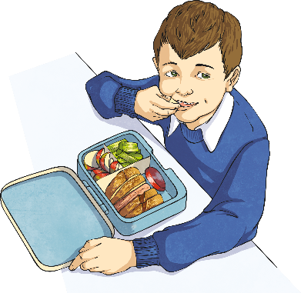
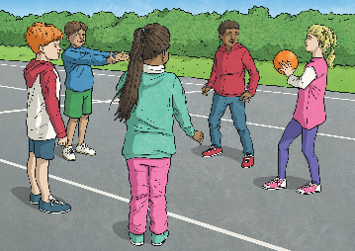


Using Your Senses
New changes in your life can bring lots of new information to your senses.
Starting school for the first time can…
look like a huge brick building.
sound like a very busy playground.
smell like new exercise books.
taste like school lunches.
feel like tight new shoes.

Slide 6
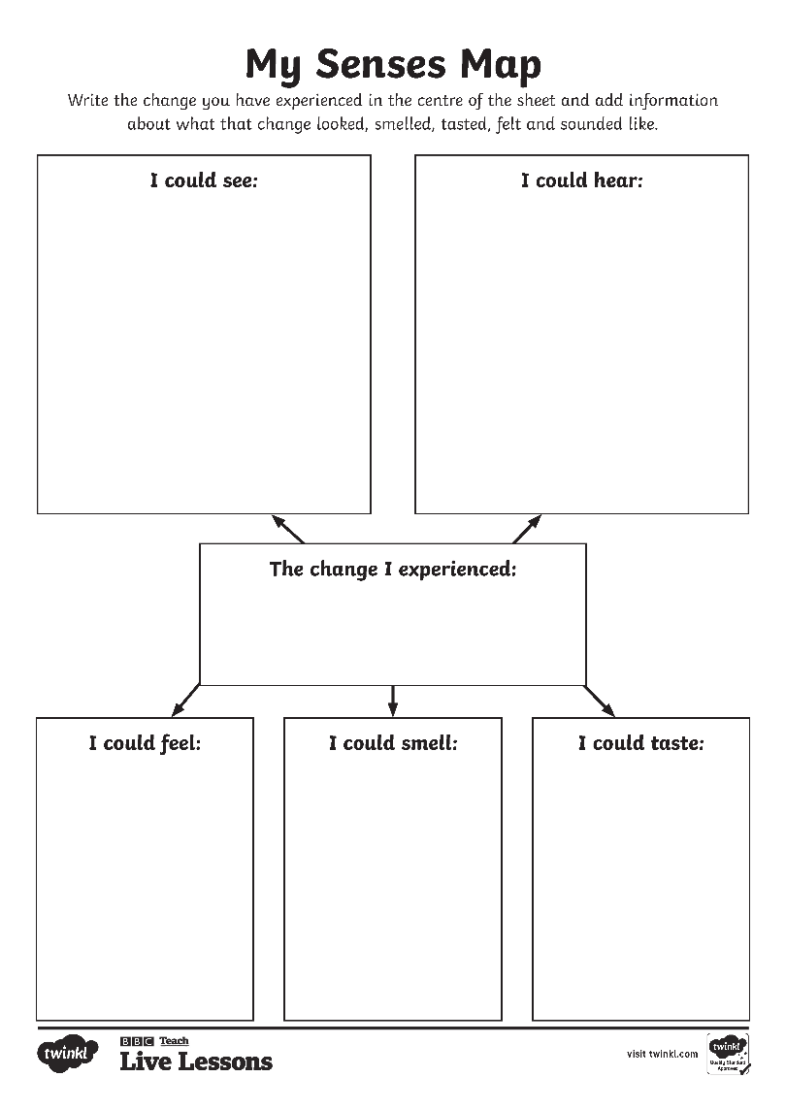

Activity 1: Using Your Senses
Think of a change you have experienced.
Use the My Senses Map Activity Sheet to write down what that change looked, smelled, tasted, felt and sounded like.
Come up with as many ideas as you can for each sense.

Slide 7


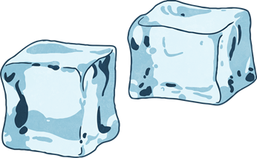

Similes
What is a simile?
A simile is when an author tells a reader that something is ‘like’ or ‘as’ something else. For example:
as cold as ice
as brave as a lion
fighting like cats and dogs

Slide 8

Similes
Quite often, similes relate to the senses.
Below are some similes you could use to describe a new baby:
as smelly as a skunk
skin as soft as silk
like an air raid siren
like a wriggly worm
as light as a feather
as sweet as a cupcake
Can you think of any more?

Slide 9

Simile Poem
Moving House
Moving house looks like mountains of cardboard boxes and a bold SOLD sign.
Moving house pops like bubble wrap and jangles like keys in a new lock.
Moving house feels like the slamming of a door and the opening of a new one.
Moving house smells as musty as old newspaper and as unfamiliar as a hidden lair.
Moving house is like the salty tears of goodbye and the sweetness of a new start.
This poem has been written about a change the poet has experienced.
It is full of similes that link to the senses.
How many can you spot?
Moving House
Moving house looks like mountains of cardboard boxes and a bold SOLD sign.
Moving house pops like bubble wrap and jangles like keys in a new lock.
Moving house feels like the slamming of a door and the opening of a new one.
Moving house smells as musty as old newspaper and as unfamiliar as a hidden lair.
Moving house is like the salty tears of goodbye and the sweetness of a new start.

Slide 10
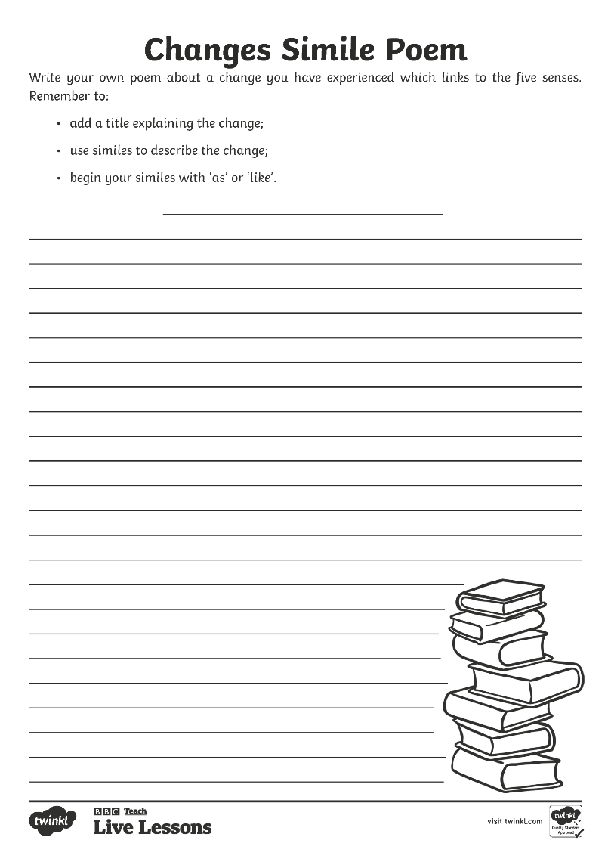

Activity 2: Using Your Senses
Using the My Senses Map Activity Sheet you have already completed, you are going to write your own poem about a change you have experienced.
Remember to:
add a title explaining the change;
use similes to describe the change;
begin your similes with ‘as’ or ‘like’.

Slide 11
To watch the BBC Teach Writing and Performance Poetry Live Lesson in full visit:
bbc.com/livelessons

